Slide 1

MARKETING PLAN
GUAN LEE HOE ENGINEERING PTE LTD
Rohaida binte Abdul Rahman 437D

Slide 2


CONTENT
Executive Summary
Persona / Ideal Customer
SWOT Analysis
Competitors Analysis –
Website
Social Media (FB,IG,Linkedin)
Meta Ads
Search Engine Marketing
Email Marketing
Marketing Prioritizing
Content, Awareness, Consideration
Marketing Prioritizing
Customer Journey (Content)
Marketing Funnel
Smart Goal
Marketing Execution

Slide 3

Executive Summary
Business Objective:
Expand market reach by increasing brand awareness and generating high-quality leads among SMEs in Singapore through digital marketing, showcasing expertise in energy-efficient ACMV systems and sustainable solutions.
Target Market:
SME business owners who are expanding and need energy-efficient ACMV solutions for new spaces, valuing sustainability, cost efficiency, and quality service.
Market Needs:
SME owners who need reliable ACMV contractors to reduce operational costs, improve workplace comfort, and align with sustainable practices, seeking expert advice, competitive pricing, and minimal disruption during projects.
Unique Value Proposition:
Guan Lee Hoe offers energy-efficient ACMV consultancy and installation, significantly reducing electricity bills and enhancing efficiency, led by experienced founder Vince and a team of Certified Green Mark Managers ensuring sustainability compliance.
Product Overview:
Guan Lee Hoe Engineering Pte Ltd offers ACMV services. Services include:
Custom ACMV systems
Solutions that save on electricity bills
Helping clients get BCA Green Mark certification
Checking and improving existing systems
Maintenance services

Slide 4

Executive Summary
Marketing Strategy:
Leveraging on digital marketing to reach and attract SME in Singapore
Search Engine Optimization (SEO):
Use relevant keywords and create helpful content.
Content Marketing:
Write blog posts and make videos about the services.
Social Media Marketing: Connect with SME owners, share news, and run targeted ads.
Email Marketing:
Send informative emails and create automated email sequences.
Pay-Per-Click (PPC) Advertising:
Run Google Ads and remarketing ads.
Website Optimization:
Improve website usability, mobile experience, and create specific landing pages.

Slide 5
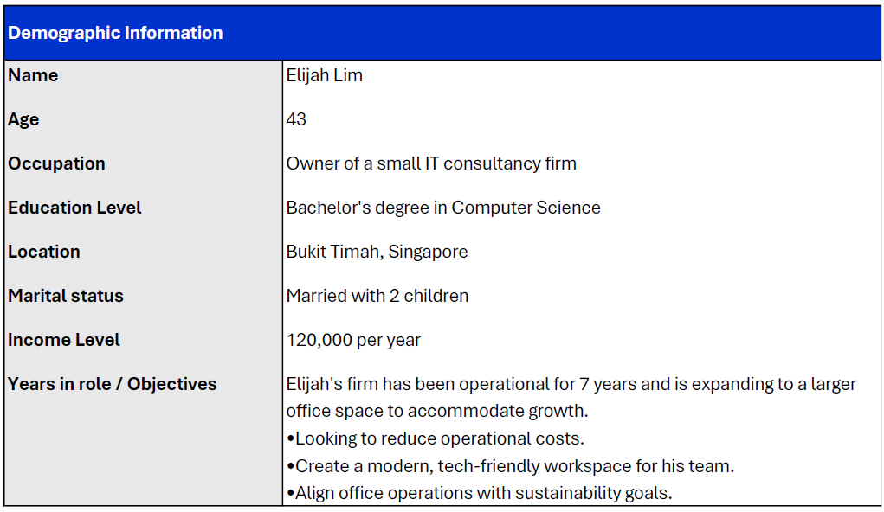

Demographic

Slide 6
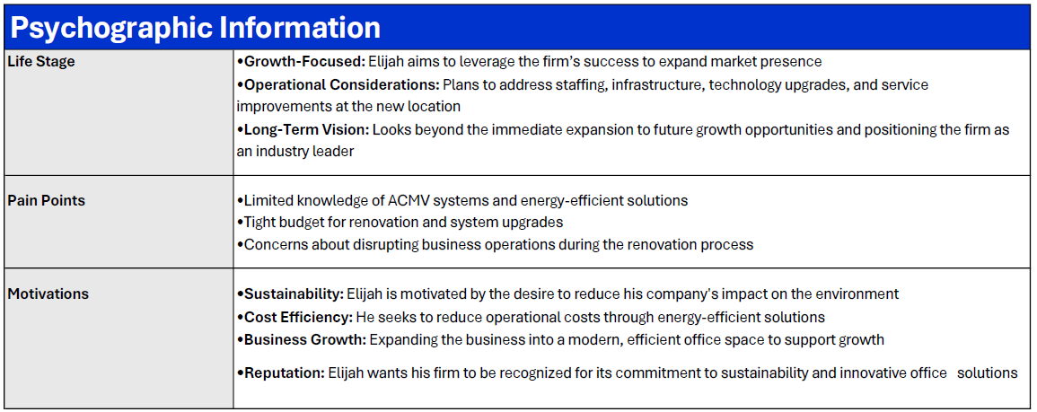
Psychographic

Slide 7
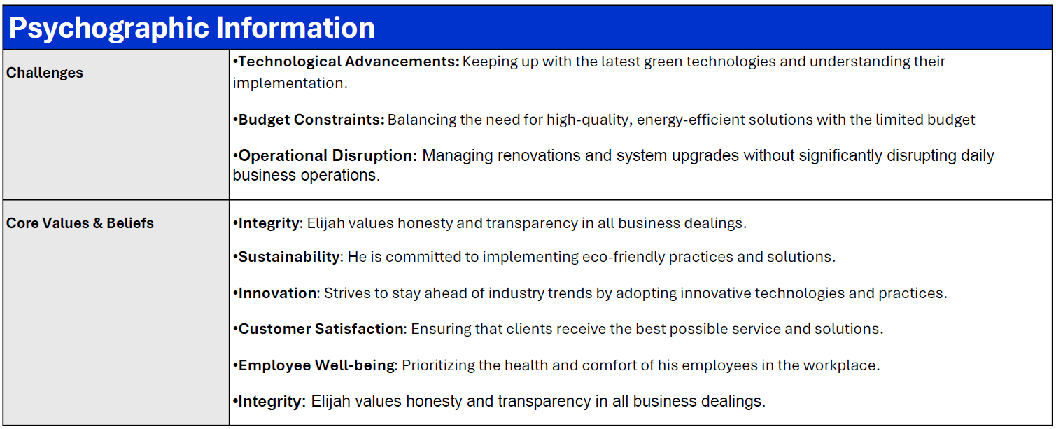
Psychographic

Slide 8
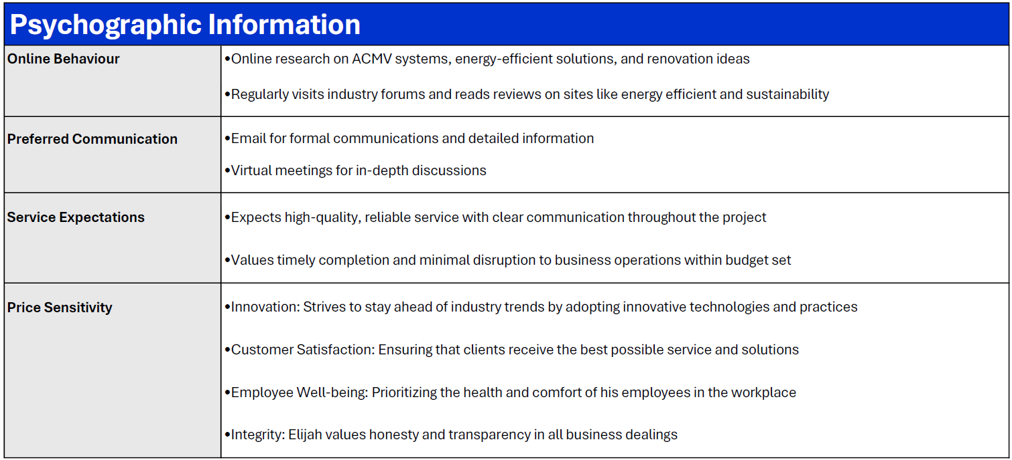
Psychographic

Slide 9
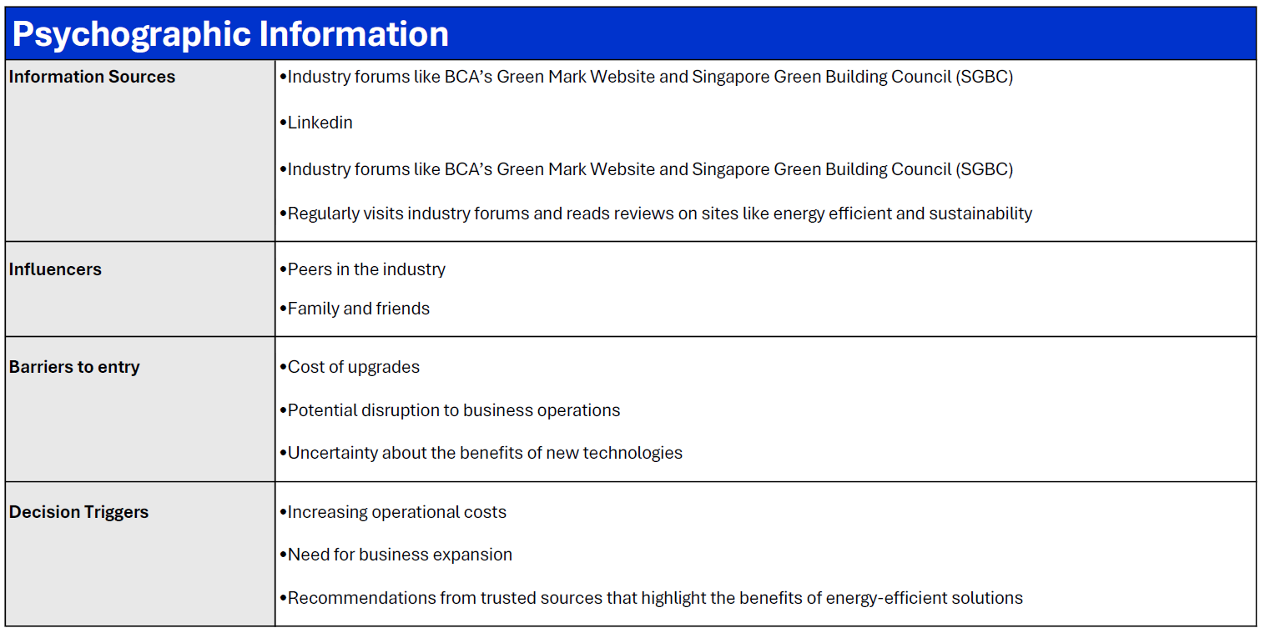
Psychographic

Slide 10

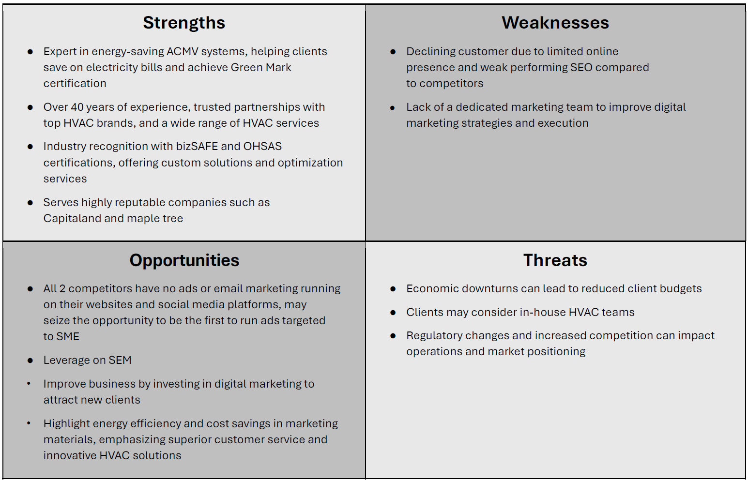
SWOT ANALYSIS

Slide 11
Website Performance

Slide 12
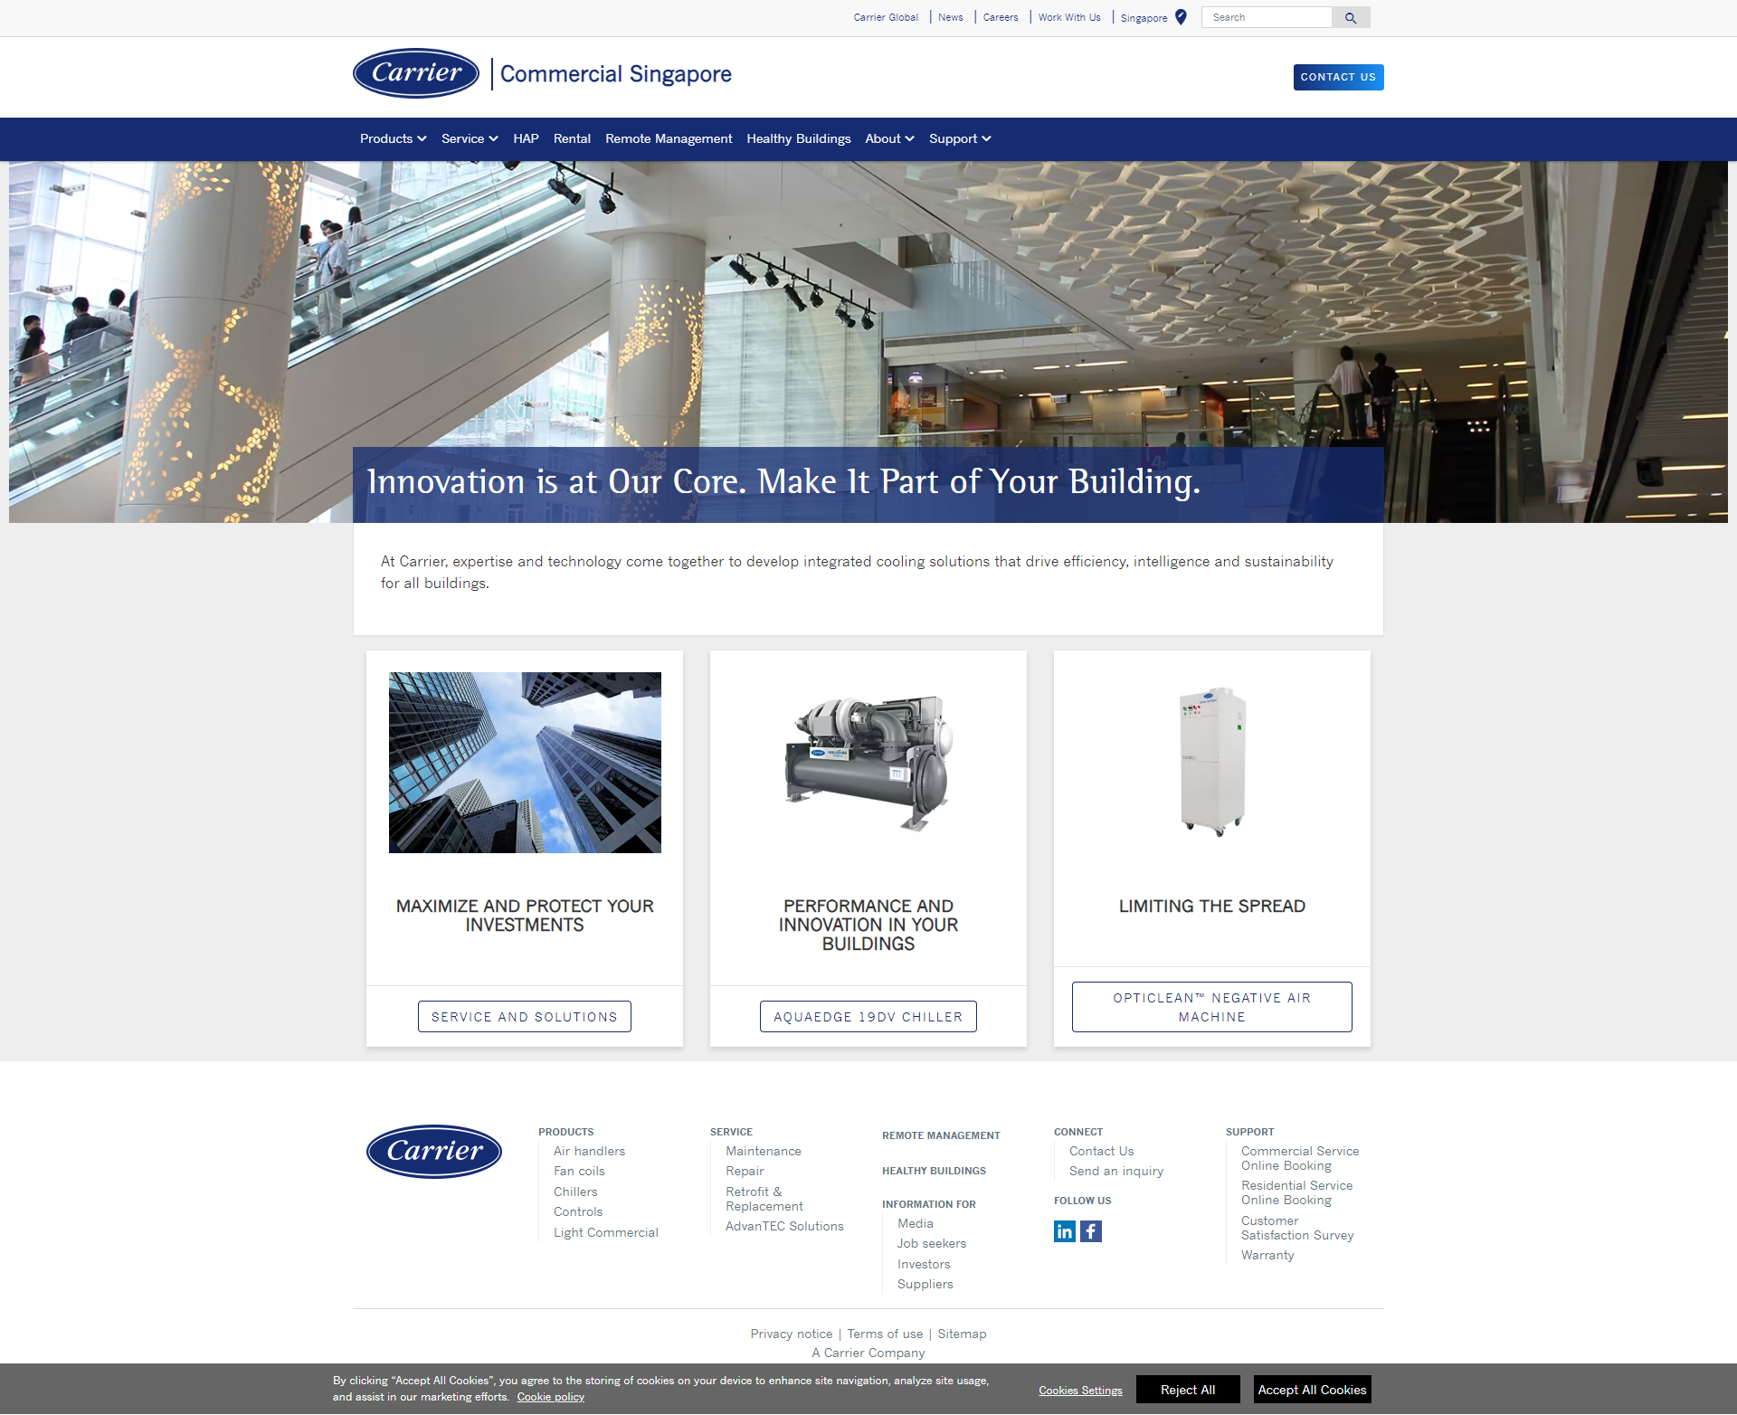
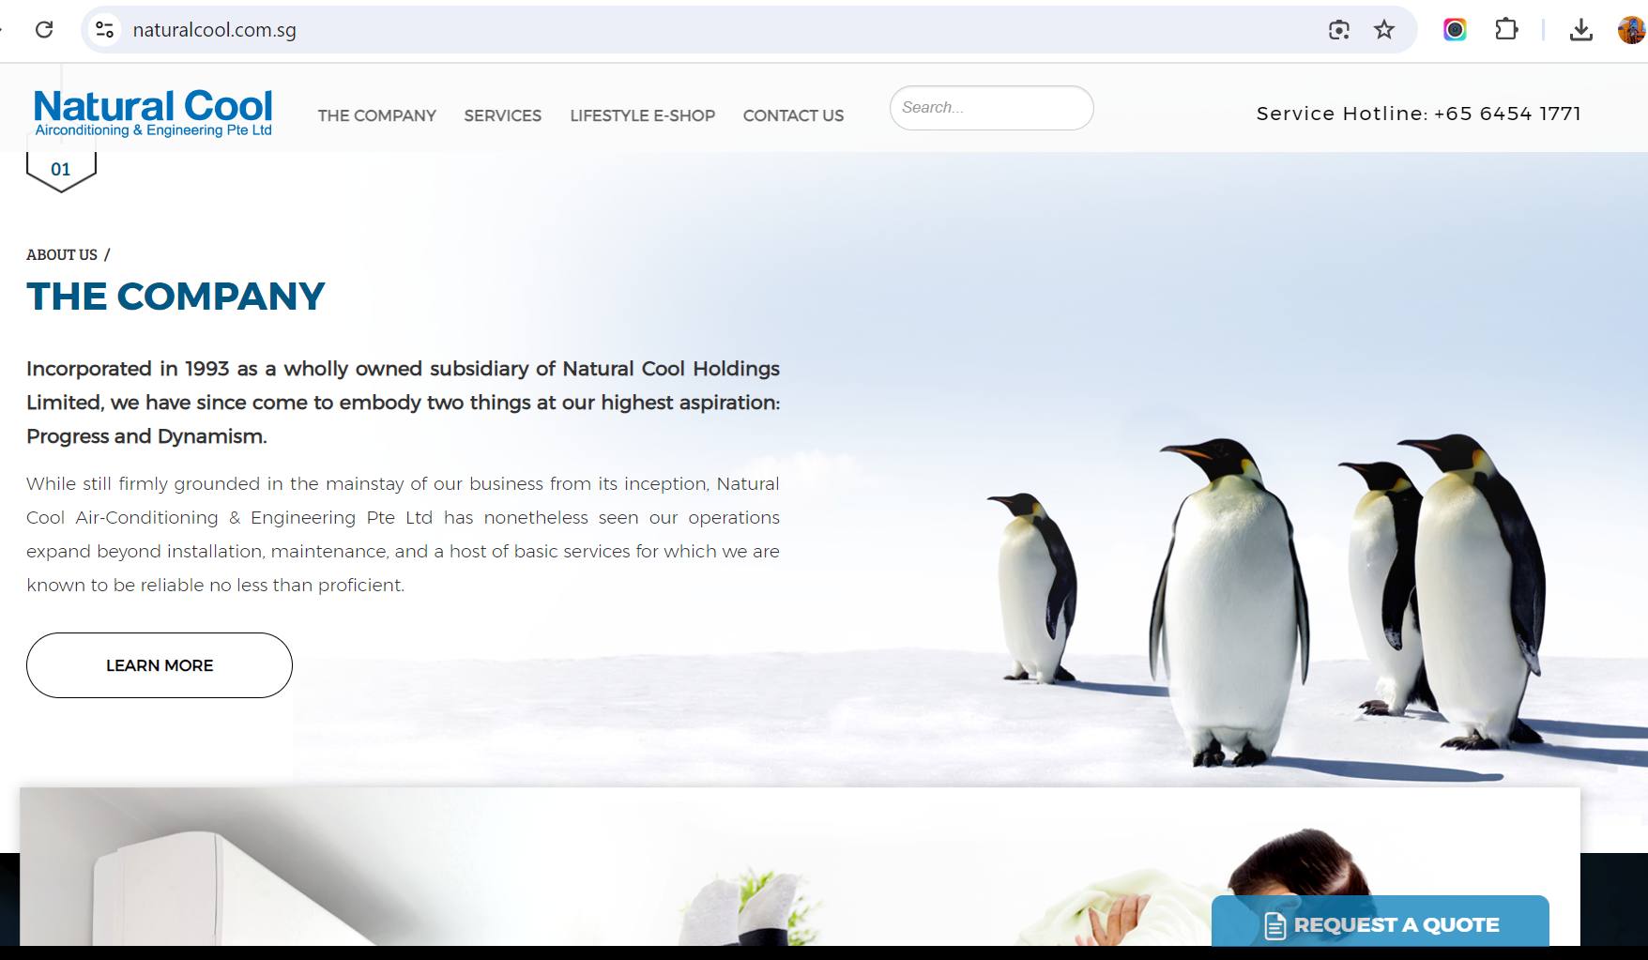
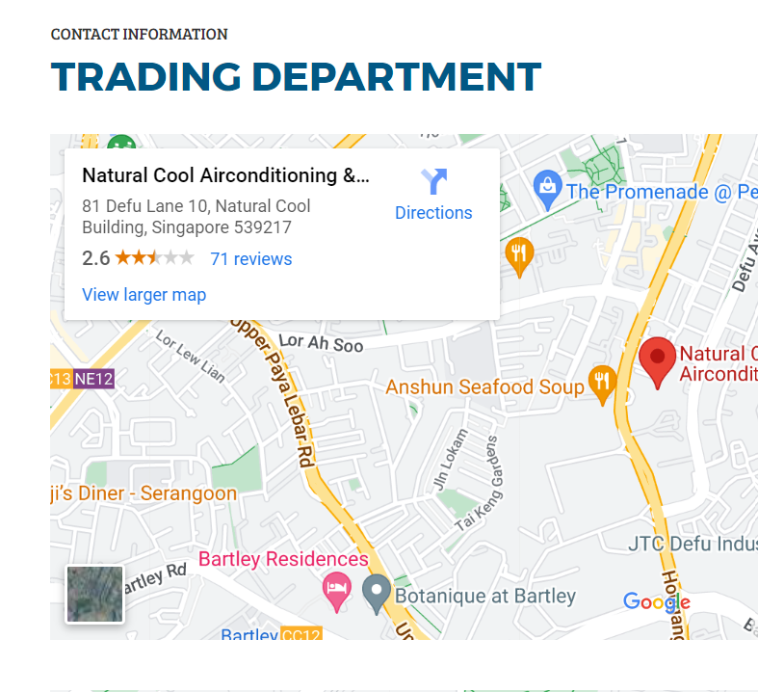
Carrier
Natural Cool

Slide 13
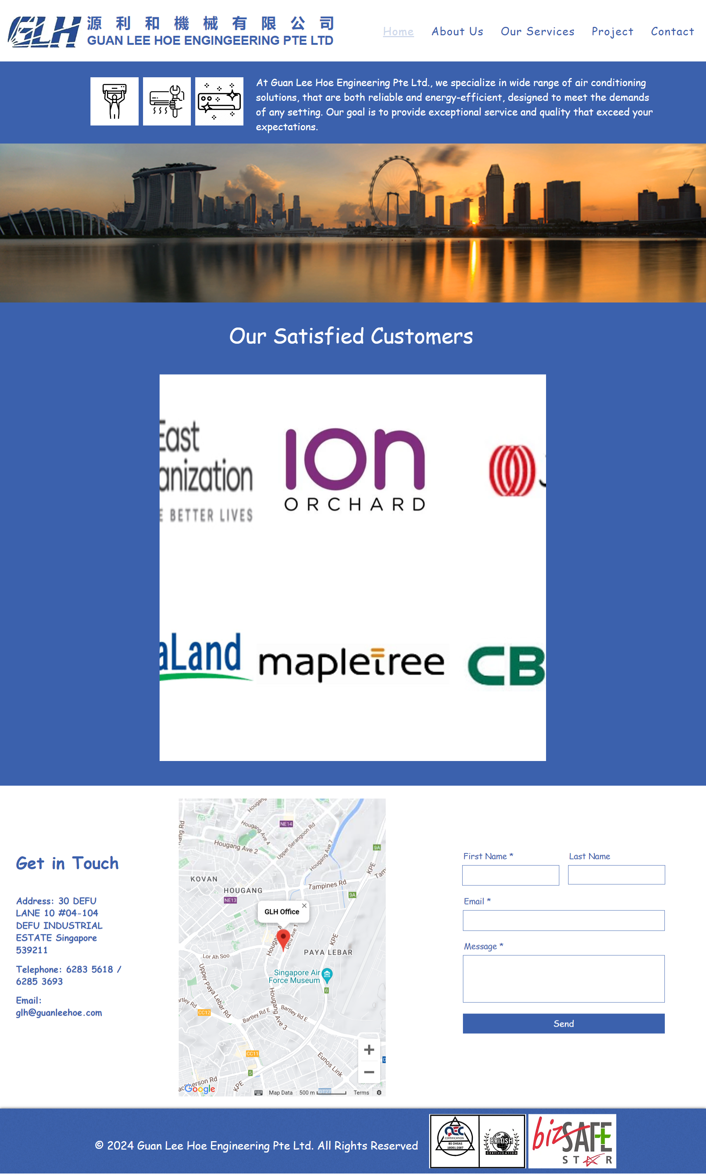
GLH
Areas of Improvement for Guan Lee Hoe Engineering Pte Ltd:
Design and Usability:
Update visuals and design
Improve user interface
User Experience:
Simplify navigation
Add interactive elements
Enhance mobile responsiveness
Content Quality and Relevance:
Expand content depth
Improve relevance
Content Strategy:
Develop content plan
Engage audience
Optimize content with relevant keywords
Summary:
Enhance website design, usability, and content strategy to improve online presence, user experience, and competitiveness in the HVAC market.

Slide 14
GLH
Natural Cool
Carrier
Metric | GLH | Carrier | Natural Cool
Authority Score | 0 | 54 | 20
Organic Search Traffic | 60 visits | 4.9K visits | 2.1K visits
Backlinks | 1 backlink | 2.1M backlinks | 602 backlinks
Top keywords (position 1) | 1 keyword | Multiple keywords | 2 keywords

Slide 15
Areas of improvements for GLH
Authority and Traffic:
Improve SEO strategies and acquire quality backlinks to increase website authority and organic traffic.
Keyword Strategy:
Optimize current keywords and target high-value, relevant terms to boost search engine rankings.
Backlink Strategy:
Engage in link-building campaigns, guest blogging, and partnerships to acquire more high-quality backlinks.
Content Optimization:
Enhance existing content with targeted keywords and create engaging, informative content to attract users and search engines.
Competitor Analysis:
Study competitors' SEO strategies and implement successful practices.
Local SEO:
Focus on local SEO techniques to capitalize on the Singapore market.

Slide 16
Social Media
Linkedin,Facebook & Instagram

Slide 17
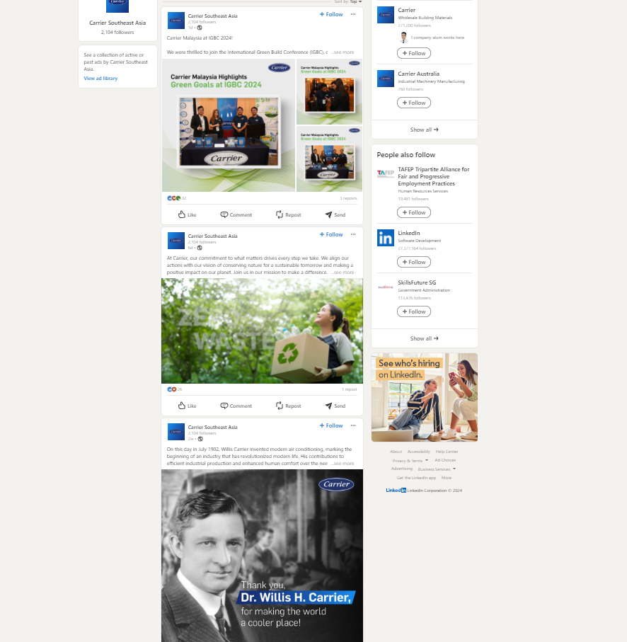
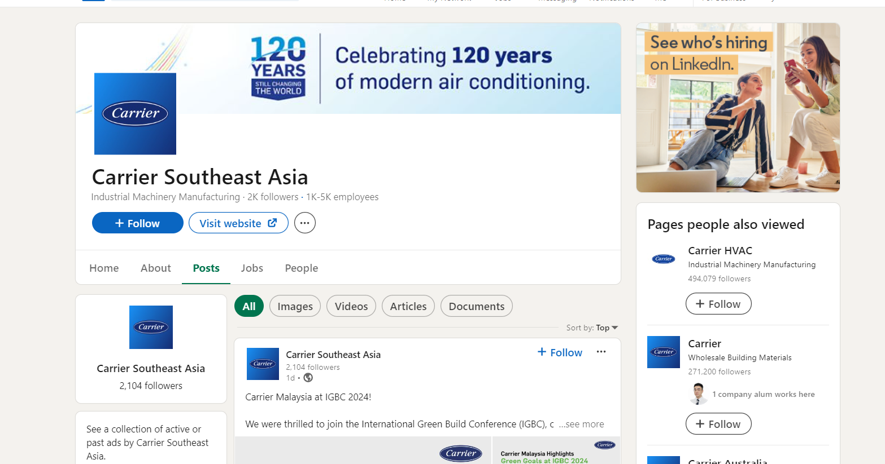
Competitors Linkedin
Carrier
Facebook Followers: 2000 users
Average likes per post: 53 likes
Shares/ Repost: 31
Types of content with high engagement:
Visual images
Infographics
Videos

Slide 18
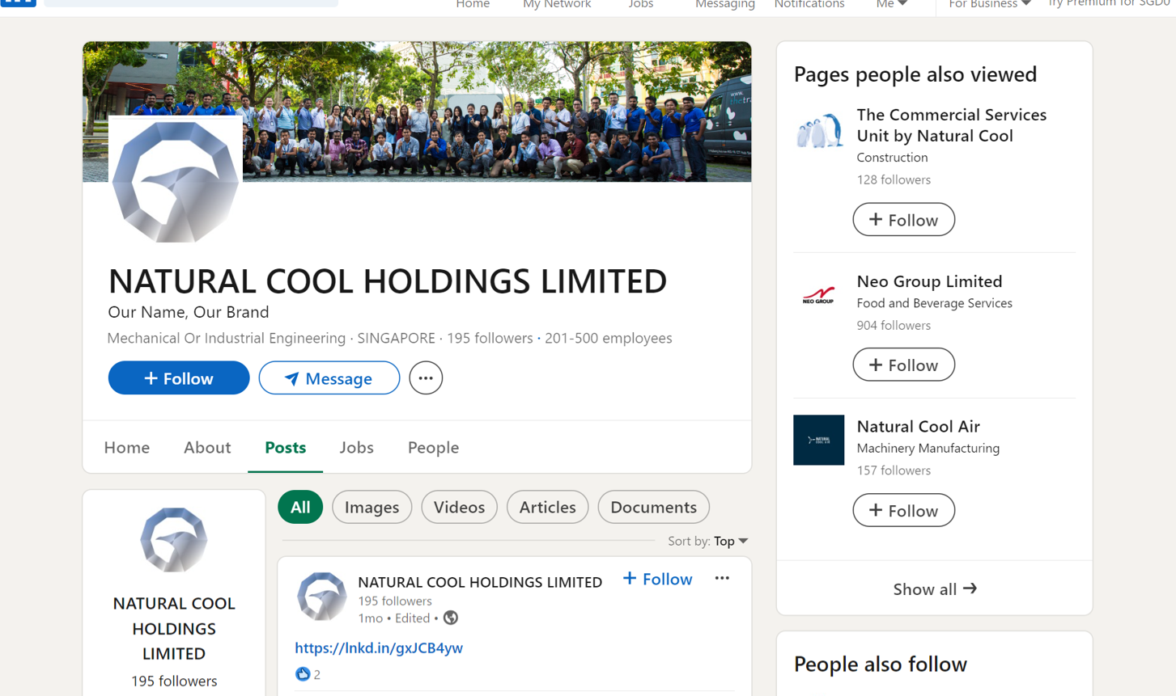
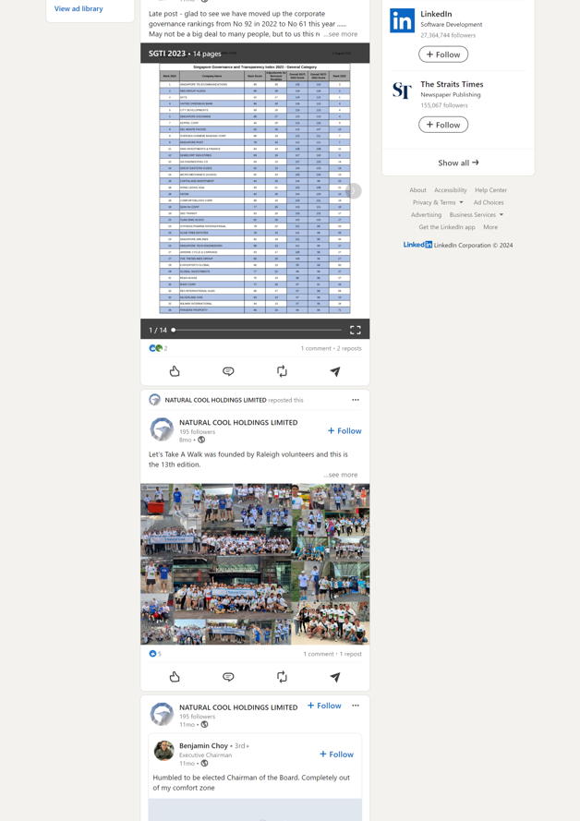
Competitors Linkedin
Natural Cool
Facebook Followers: 128 users
Average likes per post: 1
Shares/ Repost: 6
Types of content with high engagement:
Images
Infographics
Post formats:
Single images receive the most likes
Strengths:
Consistent presence in Social Media

Slide 19
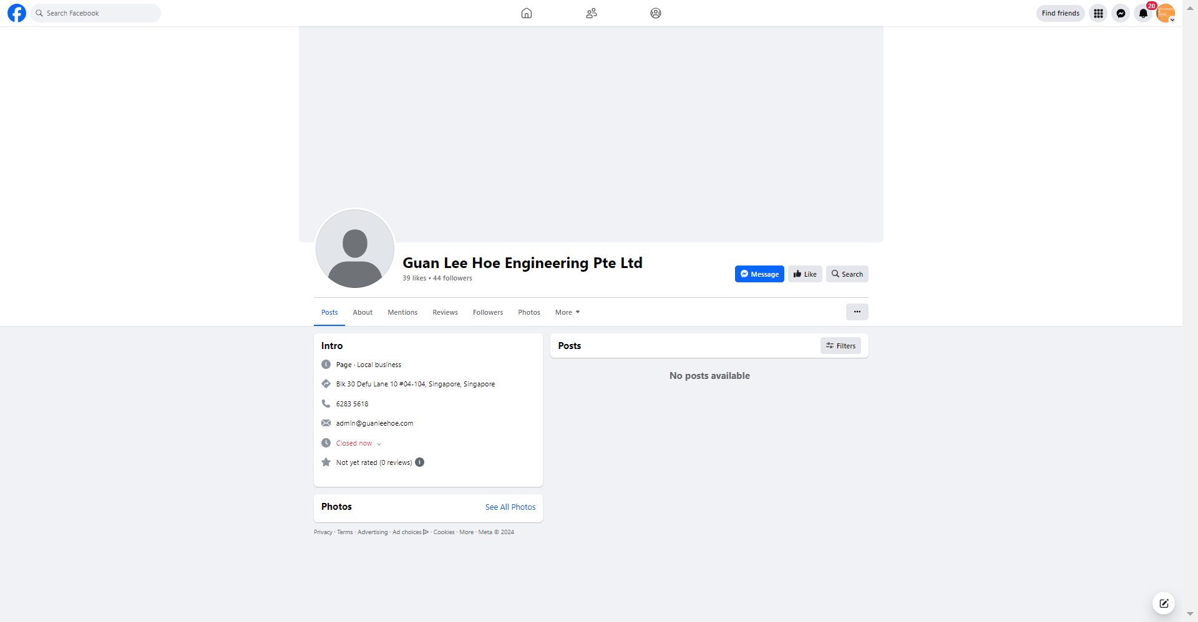
Competitors Facebook
Facebook Followers: 43 users
Likes: 38 likes
Average likes per post: 0
Types of content with high engagement:
None
Engagement strategies:
None
Guan Lee Hoe
Post formats:
None
Strengths:
None

Slide 20
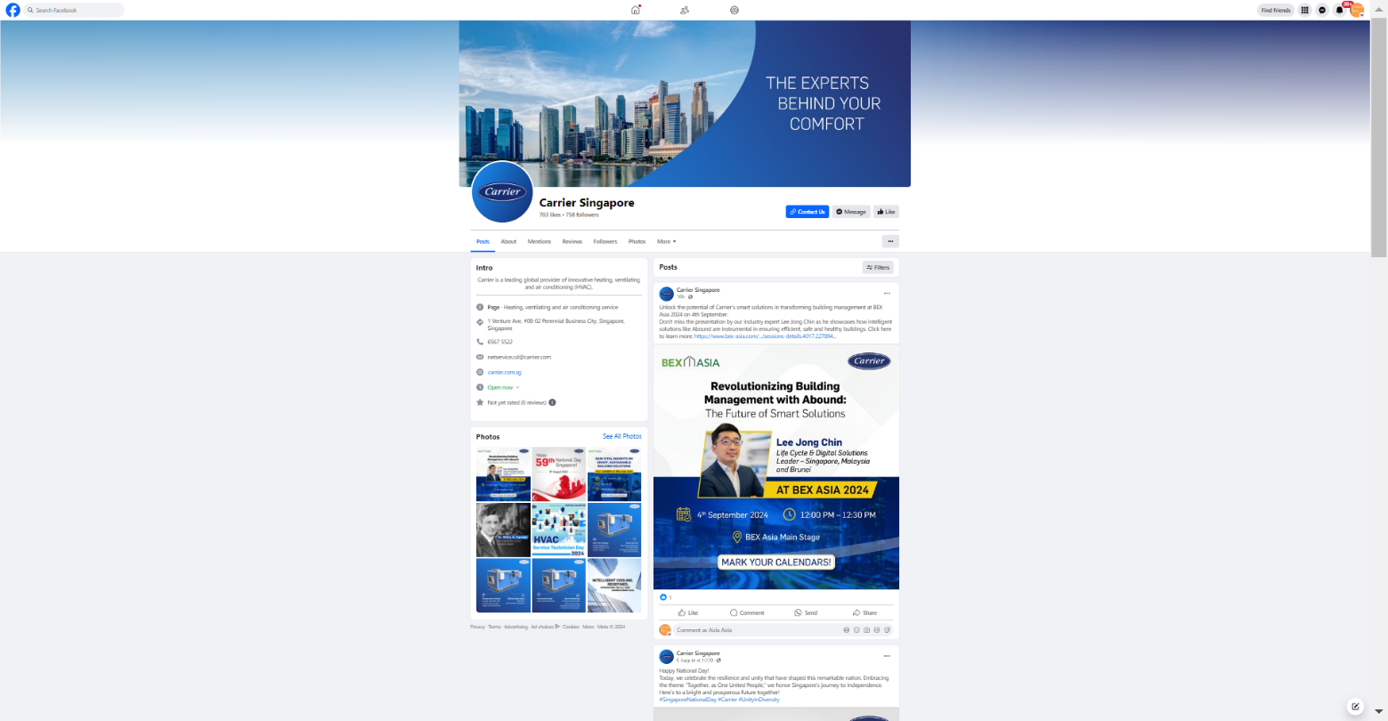
Competitors Facebook
Facebook Followers: 753 users
Likes: 703 likes
Average likes per post: 3-5
Types of content with high engagement:
Images
Videos
Products
Engagement strategies:
None
Post formats:
Videos
Infographics
Strengths:
Consistent presence on Facebook
Carrier

Slide 21
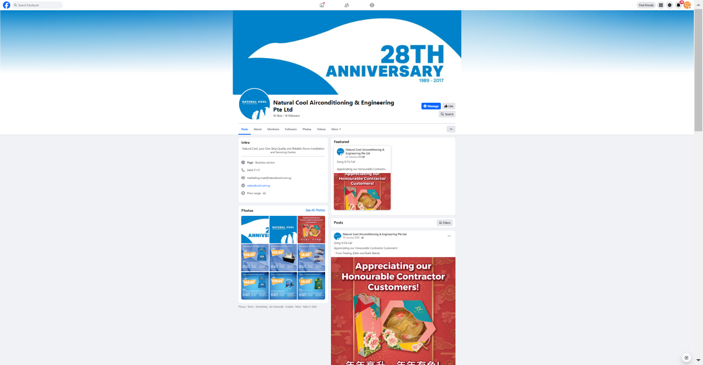
Competitors Facebook
Natural Cool
Facebook Followers: 1000 users
Likes: 1000 likes
Average likes per post: 3-5
Types of content with high engagement:
Images
Videos
Products
Engagement strategies:
Encourages user-generated content
Post formats:
Single images receive the most likes
Videos and carousels generate more engagement
Strengths:
periodical presence on Facebook
Effective at engaging with their audience

Slide 22
Areas of improvements for GLH
Increase Engagement:
Post regularly
Use interactive content
Feature user-generated content
Content Variety:
Incorporate visuals
Share educational posts
Showcase behind-the-scenes
Targeted Advertising:
Run ad campaigns
Use remarketing tools
Community Building:
Engage in Facebook groups
Partner with other businesses
Analytics and Feedback:
Monitor Facebook Insights
Seek and respond to feedback

Slide 23
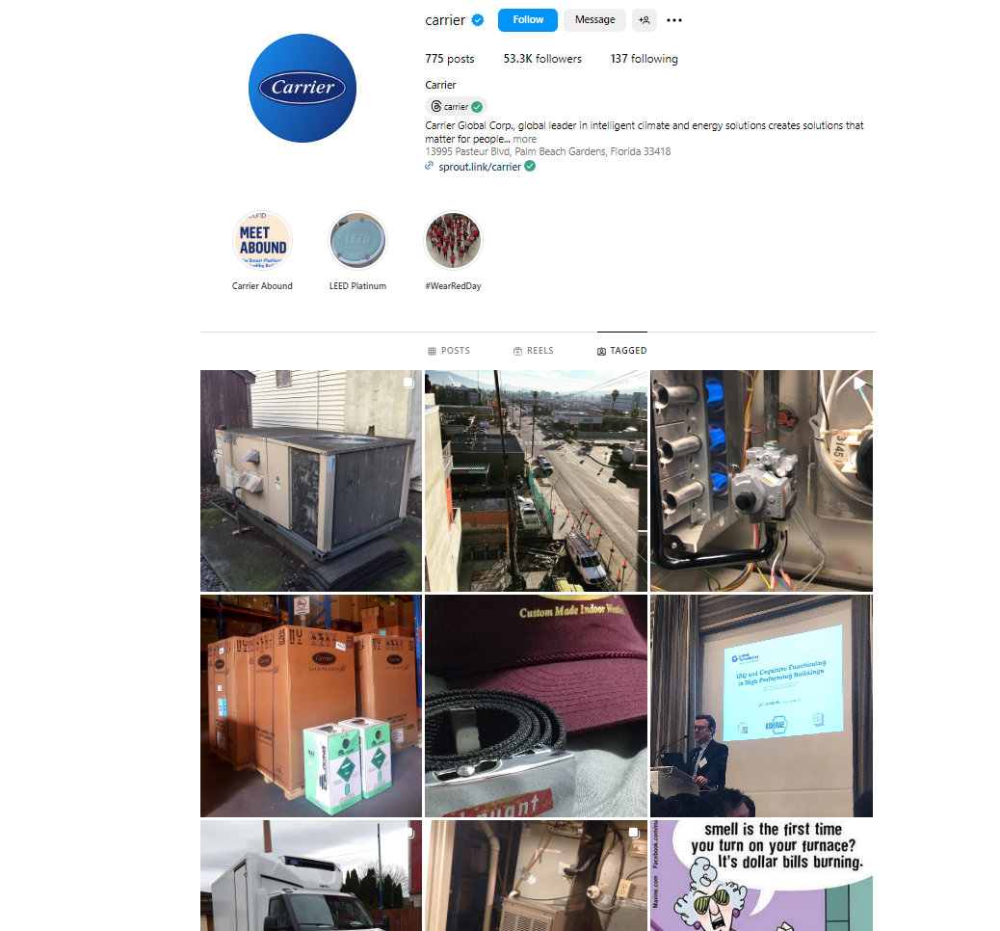
Competitors Instagram
Carrier
IG Followers: 53.3K users
Average likes per post: 50-200
Types of content with high engagement:
Images
Videos
Engagement strategies:
Encourages user-generated content
Post formats:
Single images receive the most likes
Videos generate more comments
Strengths:
Consistent presence on Instagram
Effective at engaging with their audience

Slide 24
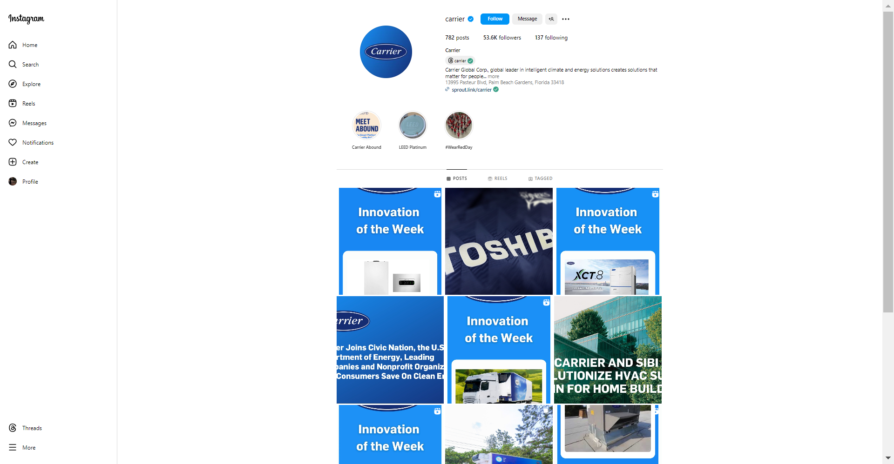
Competitors Instagram
Natural Cool
IG Followers: 20 users
Average likes per post: 0
Types of content with high engagement
None
Engagement strategies:
None
Post formats:
Images
Videos
Strengths:
Consistent presence on Instagram

Slide 25
Areas of improvements for GLH
To create a strong Instagram presence, increase brand awareness, and engage with potential clients and industry peers.
Set up a Professional Account
Post Engaging Visuals
Use Hashtags and Geotags
Post Consistently
Engage with Users
Run Targeted Ads
Monitor Performance
Example Content Ideas:
"Project Sneak Peek" series
"Meet the Team" features
"Industry Trends and Tips" posts

Slide 26
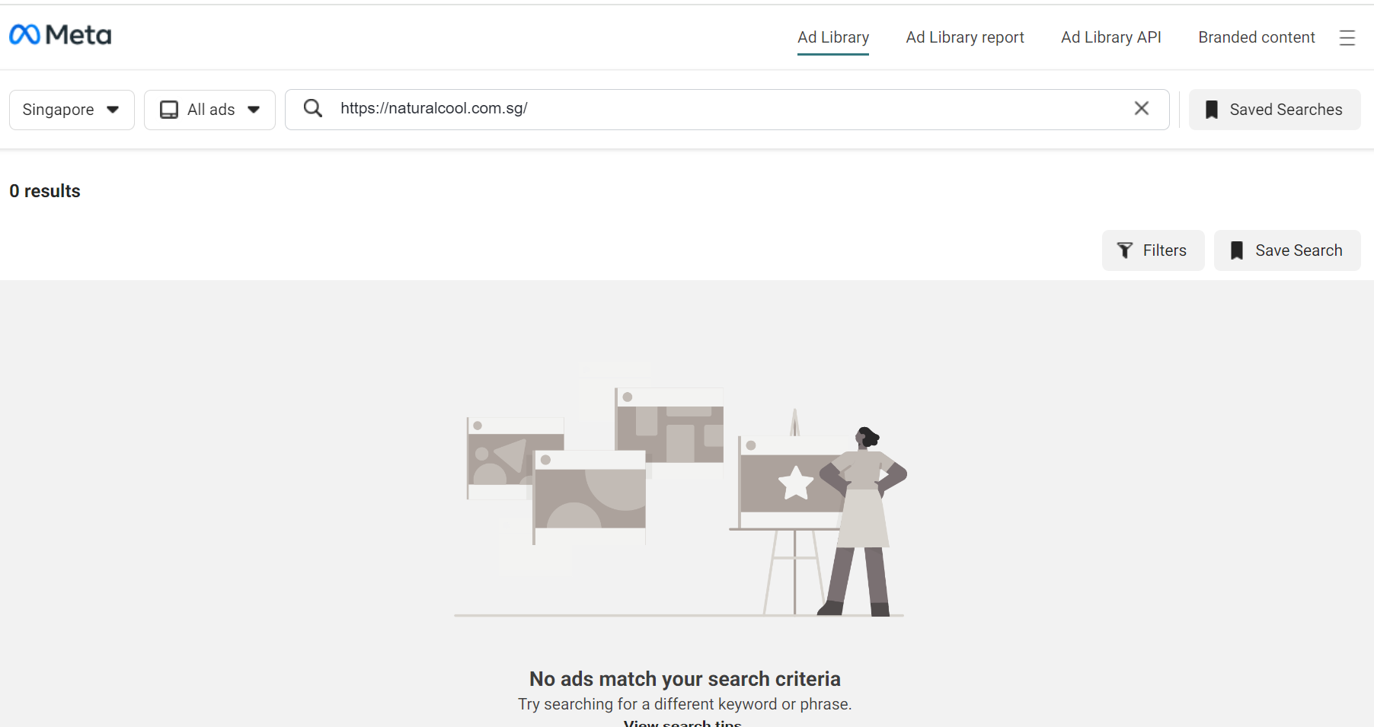
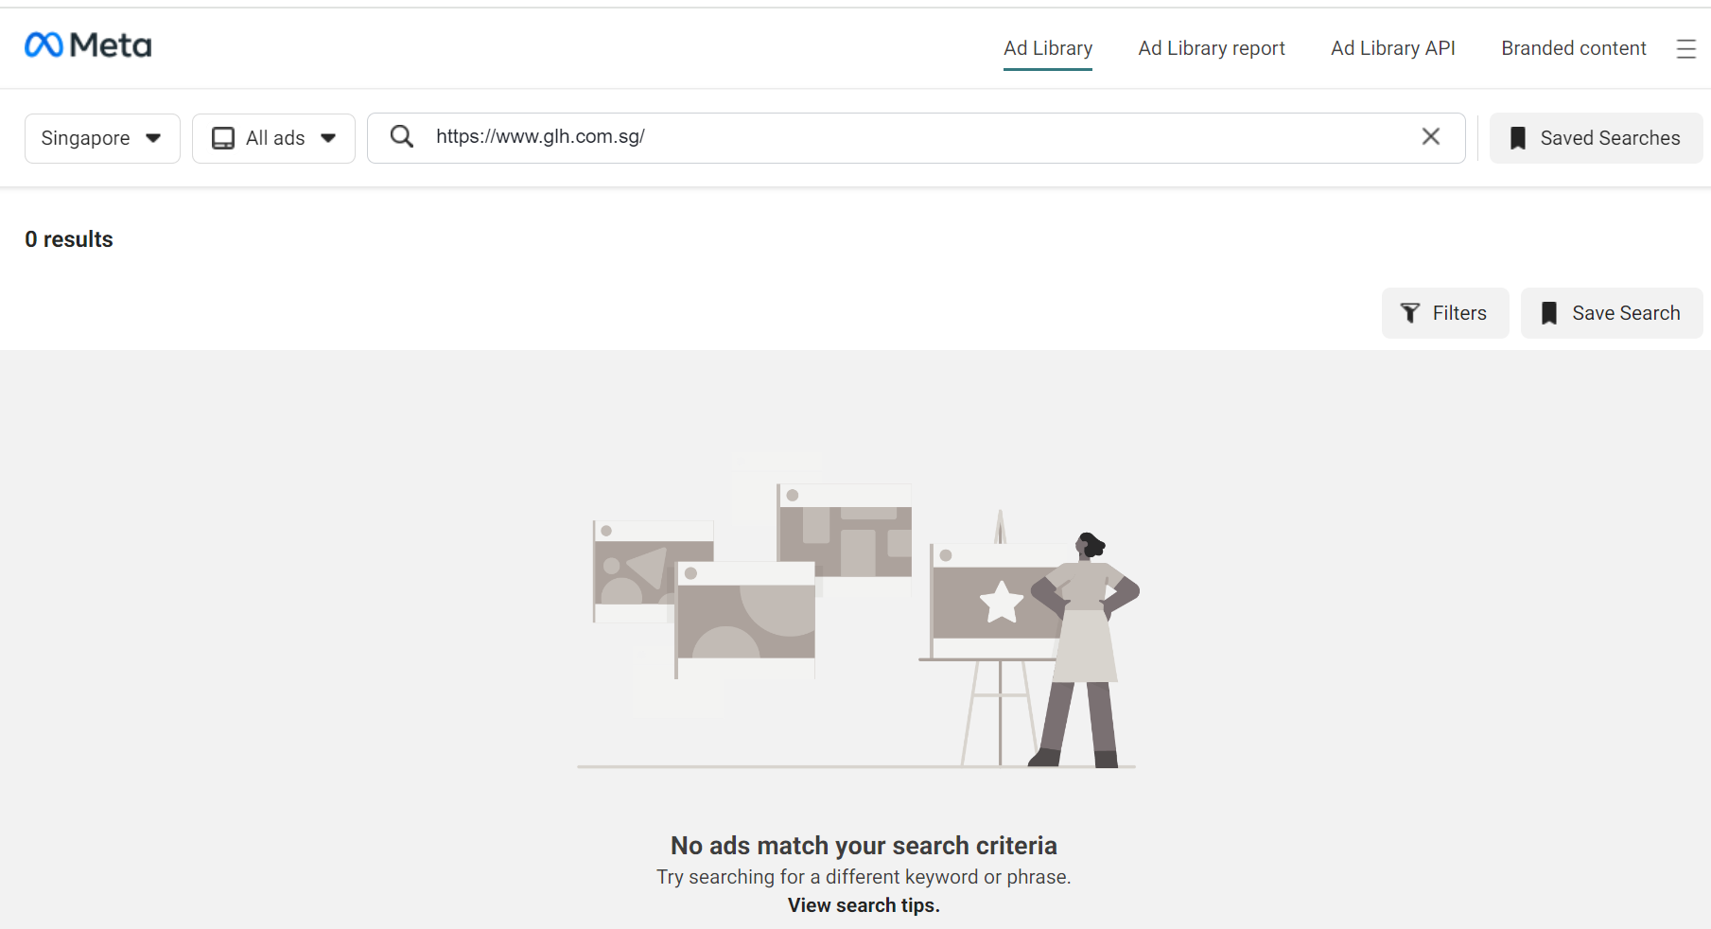
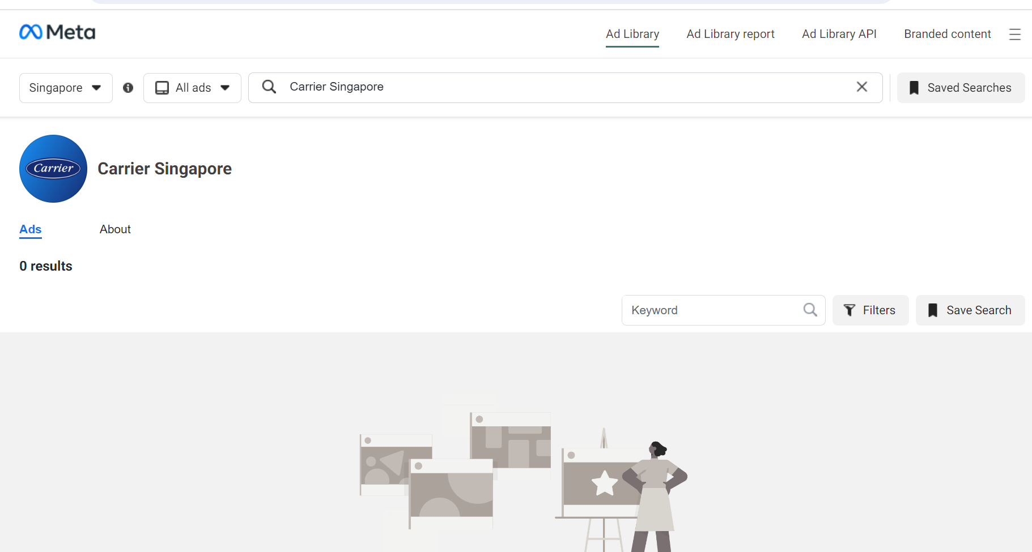
Meta Tags
No Meta Ads found for Guan Lee Hoe and competitors
Carrier
Natural Cool

Slide 27
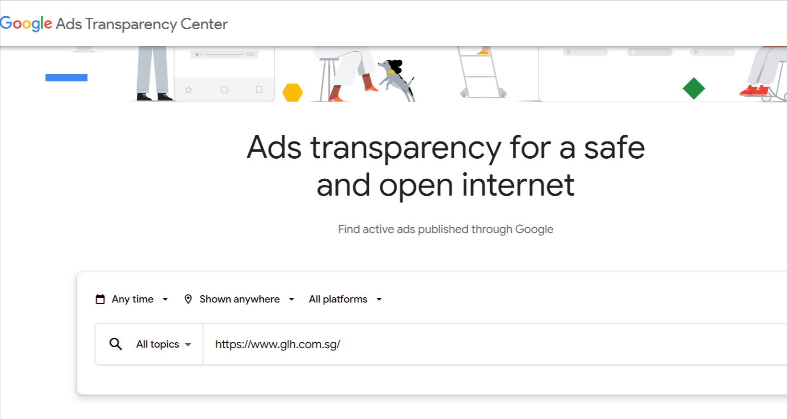
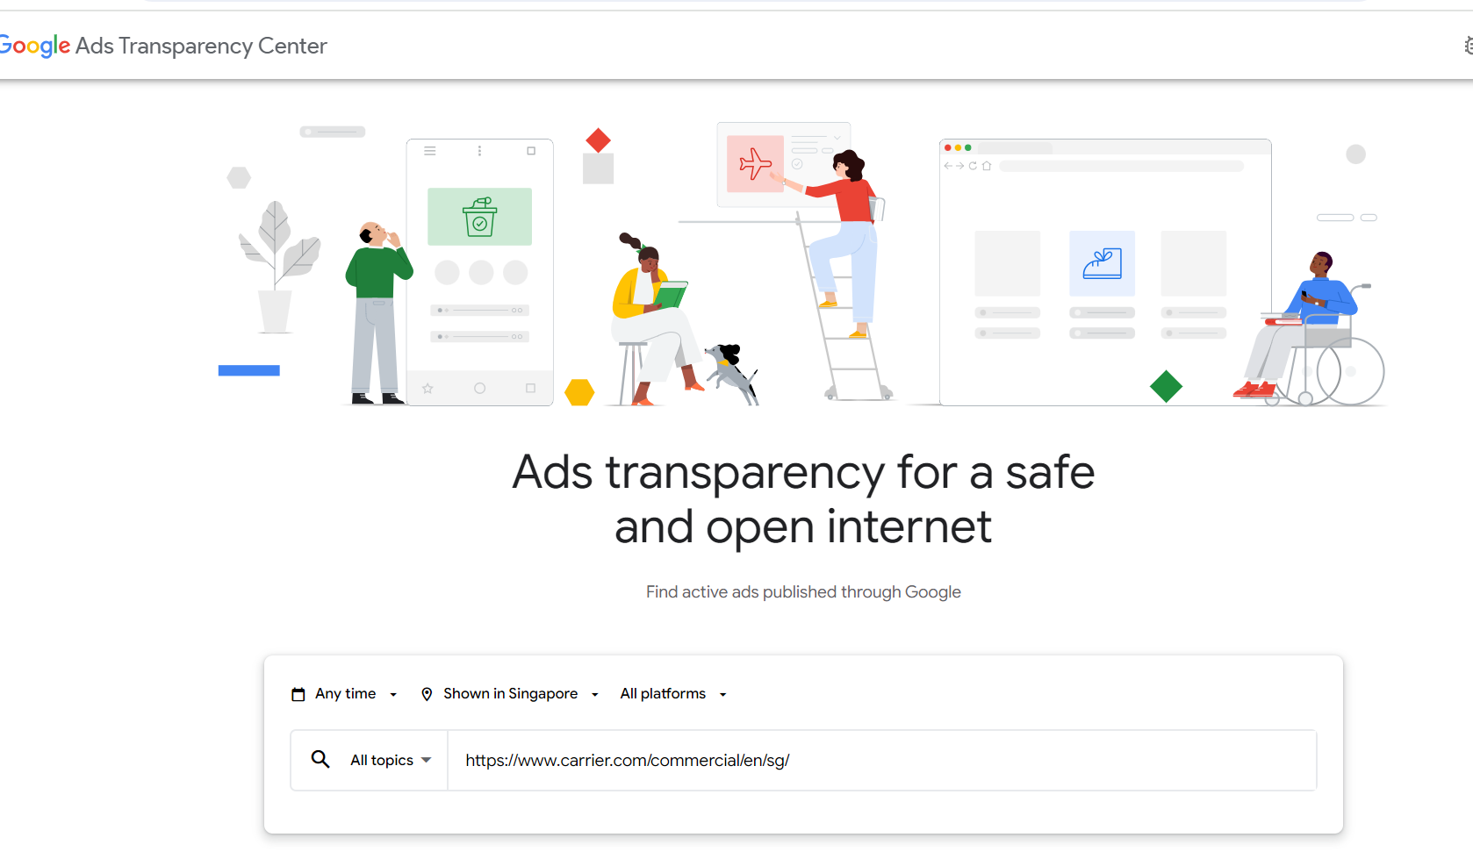
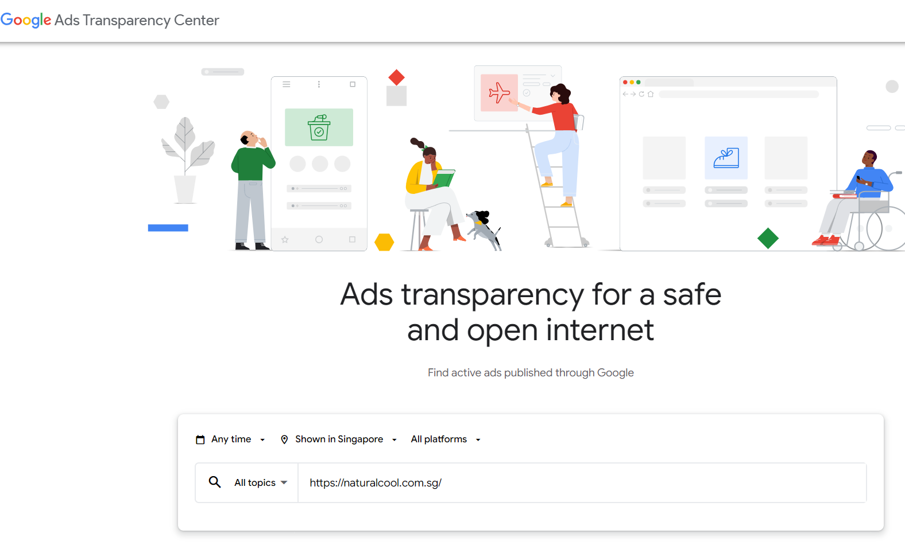
Search Engine Marketing
No SEM found for Guan Lee Hoe and competitors
Carrier
Natural Cool

Slide 28
Email Marketing
No available email marketing features on
GLH
Carrier
Natural Cool

Slide 29
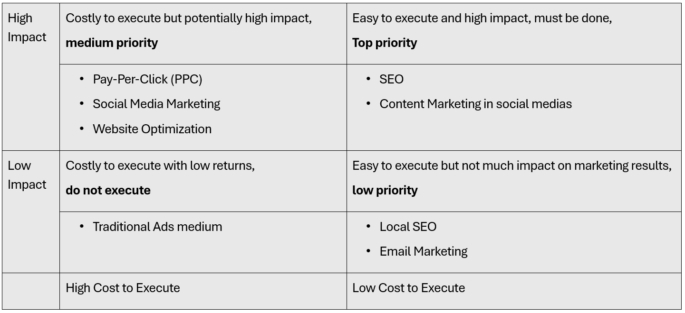
Marketing Prioritization

Slide 30
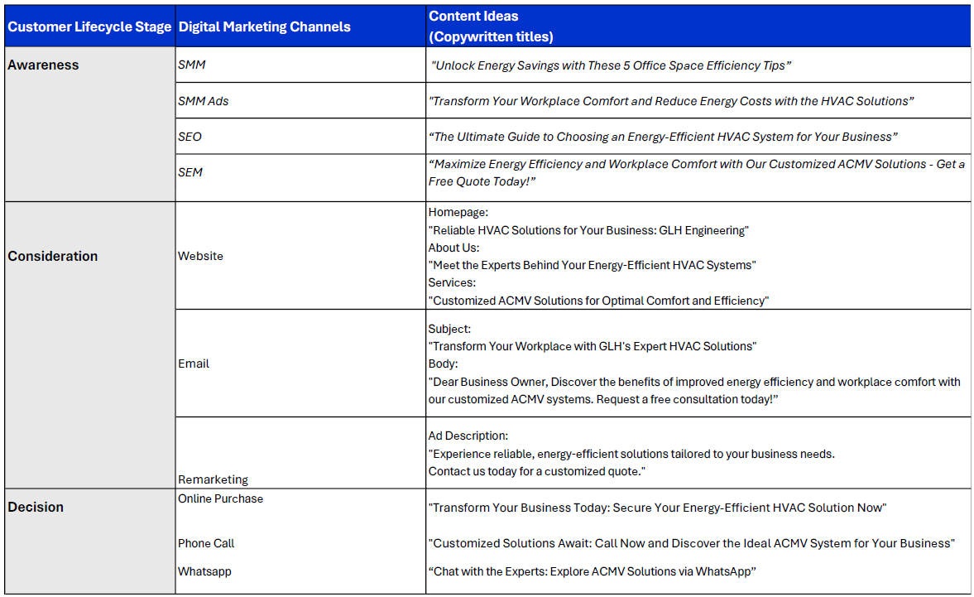
Customer Journey (Content)

Slide 31
Marketing Funnel
Attention
01
SEO and SEM: Optimize for search visibility
Social Media Campaigns: Engage with visual content
Interest
02
Websites: Provide case studies, informative articles and videos
Social Media: Drive traffic and increase brand visibility via posts, videos and visual content
Desire
03
Websites: Showcase testimonial
Social Media: Share clients success stories and project results
Action
04
Websites: Use clear CTAs and landing page for conversion
Social Media: Promote offers and CTAs for immediate action
Online Advertisements: Run ads with direct CTAs to drive conversion

Slide 32
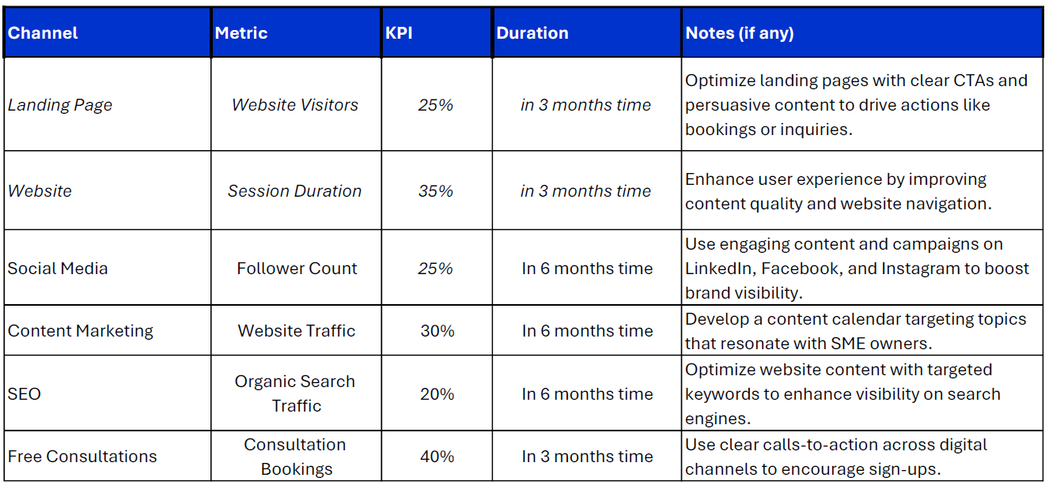
Smart Goal

Slide 33
MARKETING EXECUTION

Slide 34
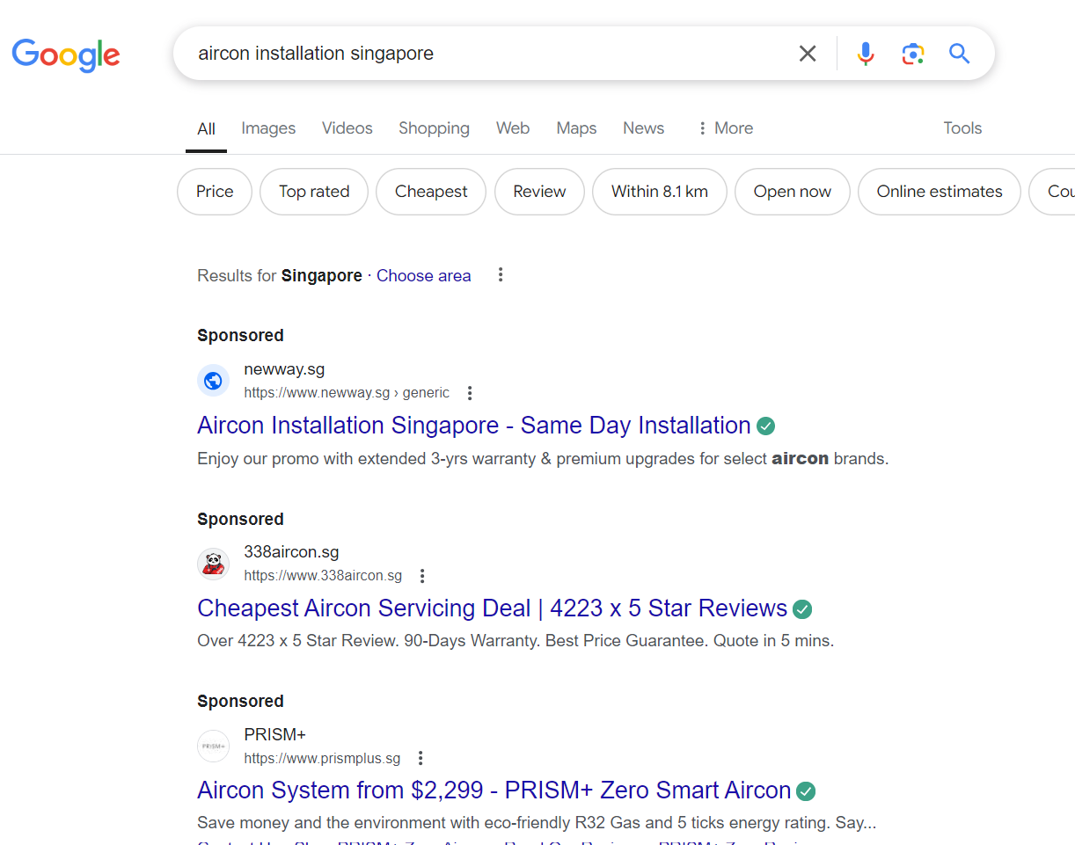
SEM – Google Search
Aircon companies in Singapore use SEM for better visibility in search engine results.
Top companies include Newway.sg, 338aircon.sg, and PRISM+.
They focus on unique selling points like same-day installation, competitive pricing, and eco-friendly systems.
Promotional offers, customer reviews, and extended warranties are used to attract customers.
The competitive Singaporean market underscores the importance of paid advertising for air conditioning businesses.

Slide 35
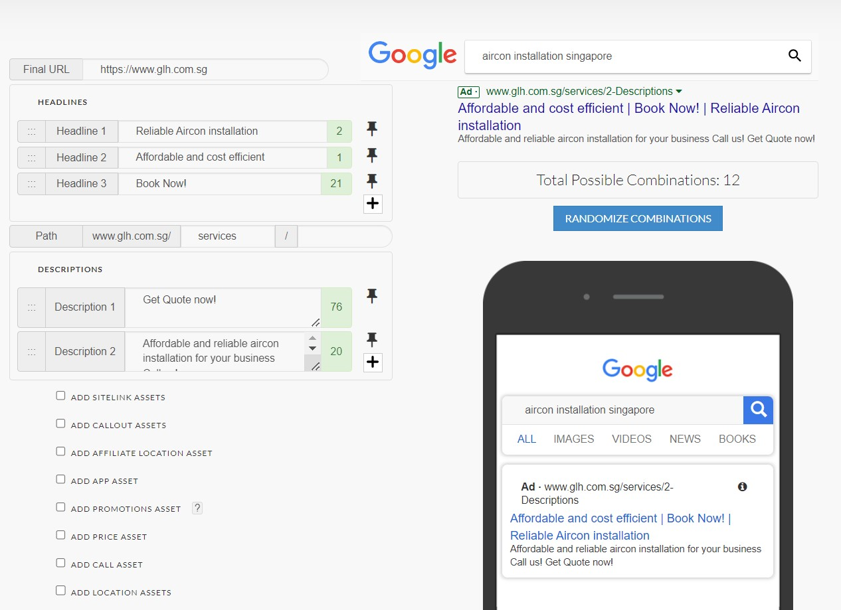
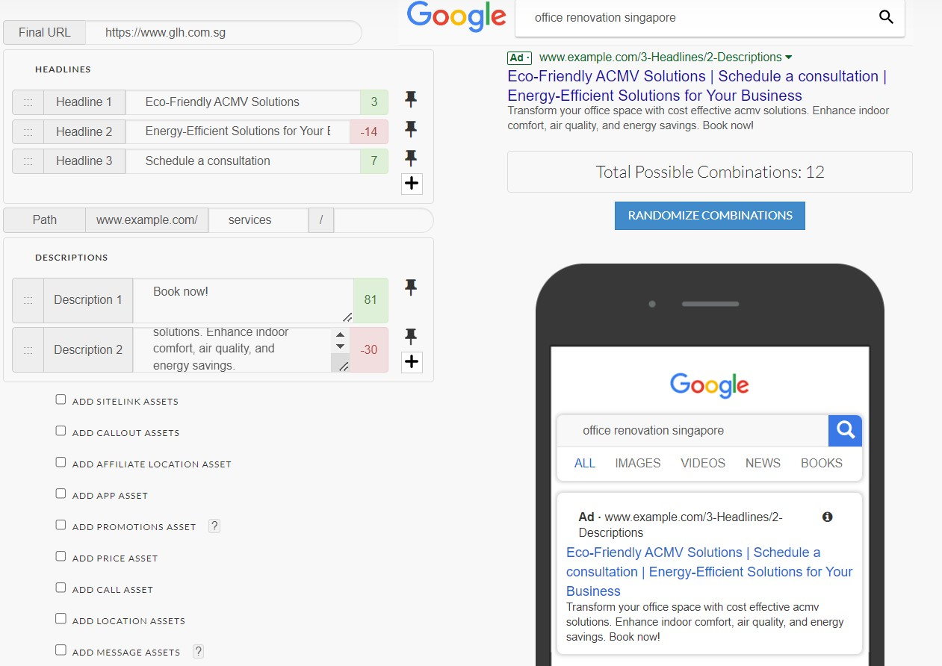
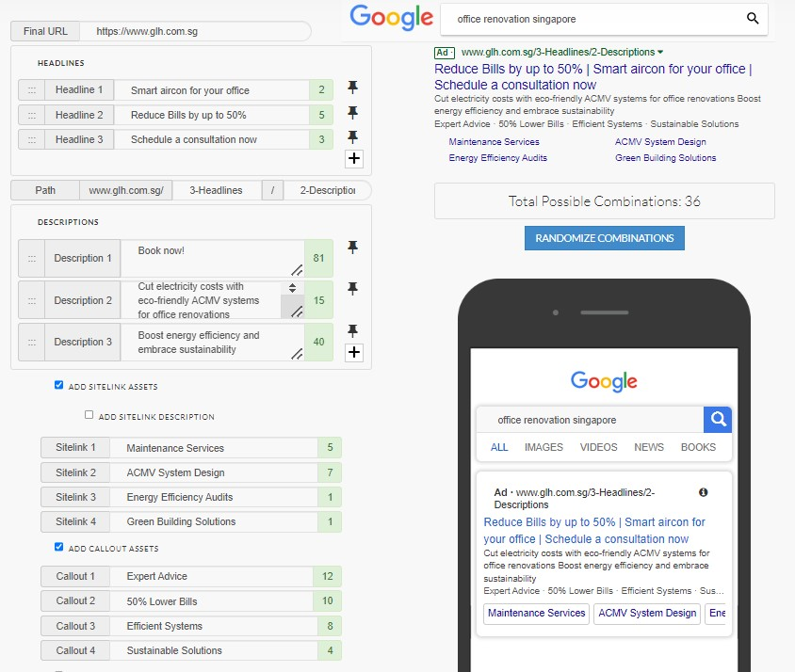
SEM – Google Search

Slide 36
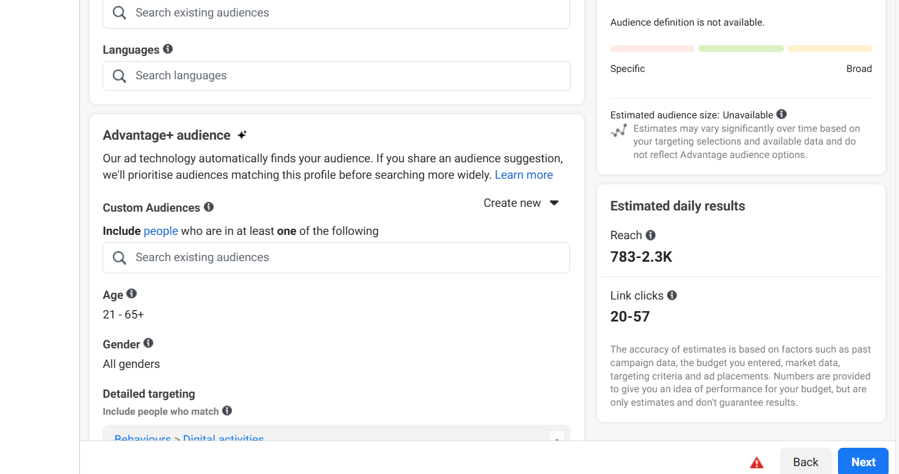
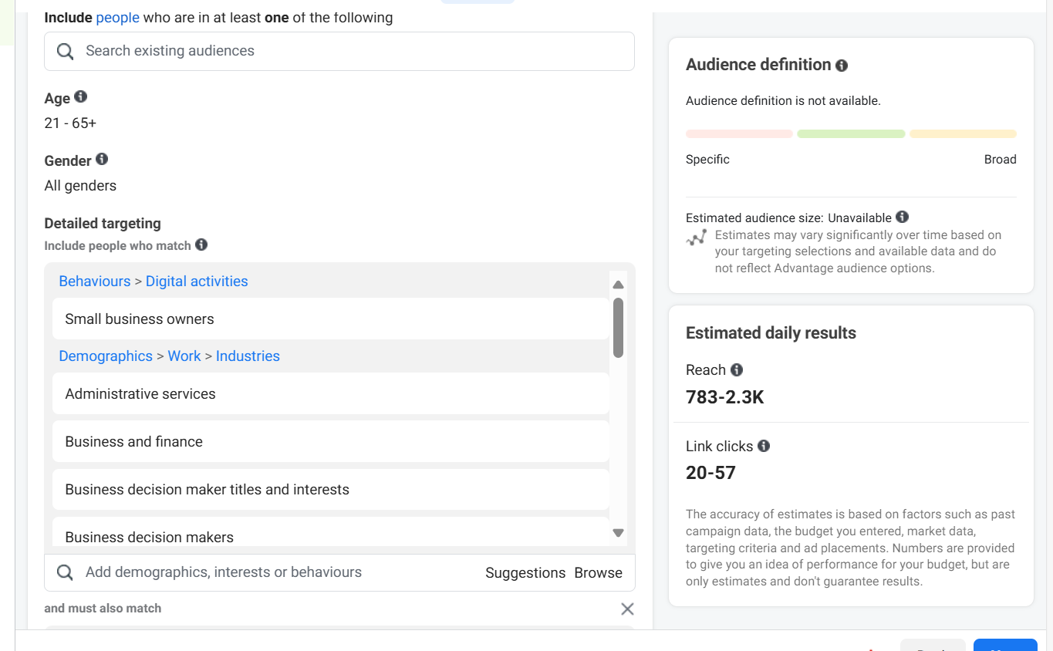
SEM – Google Search (Target Audience)

Slide 37
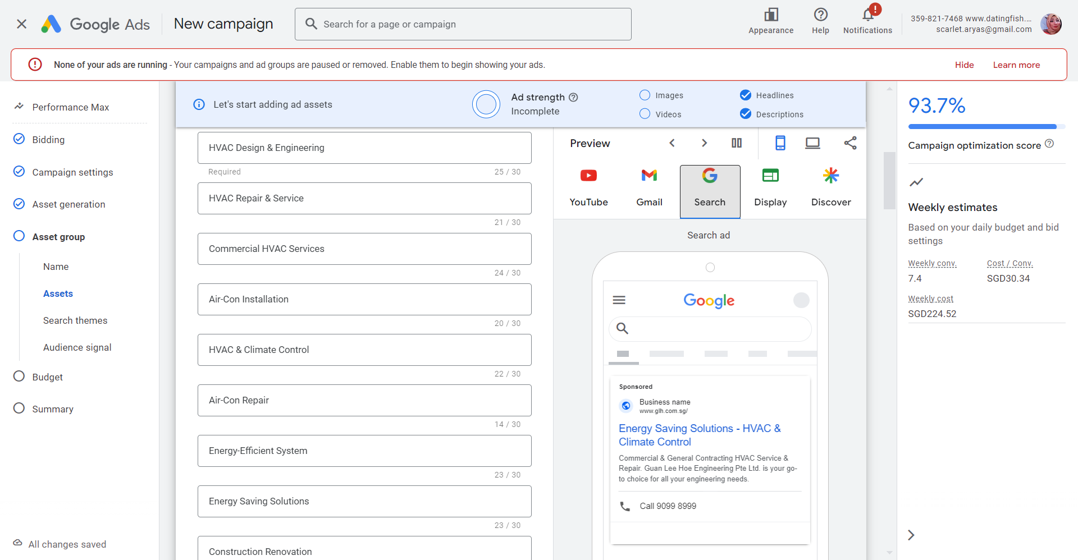
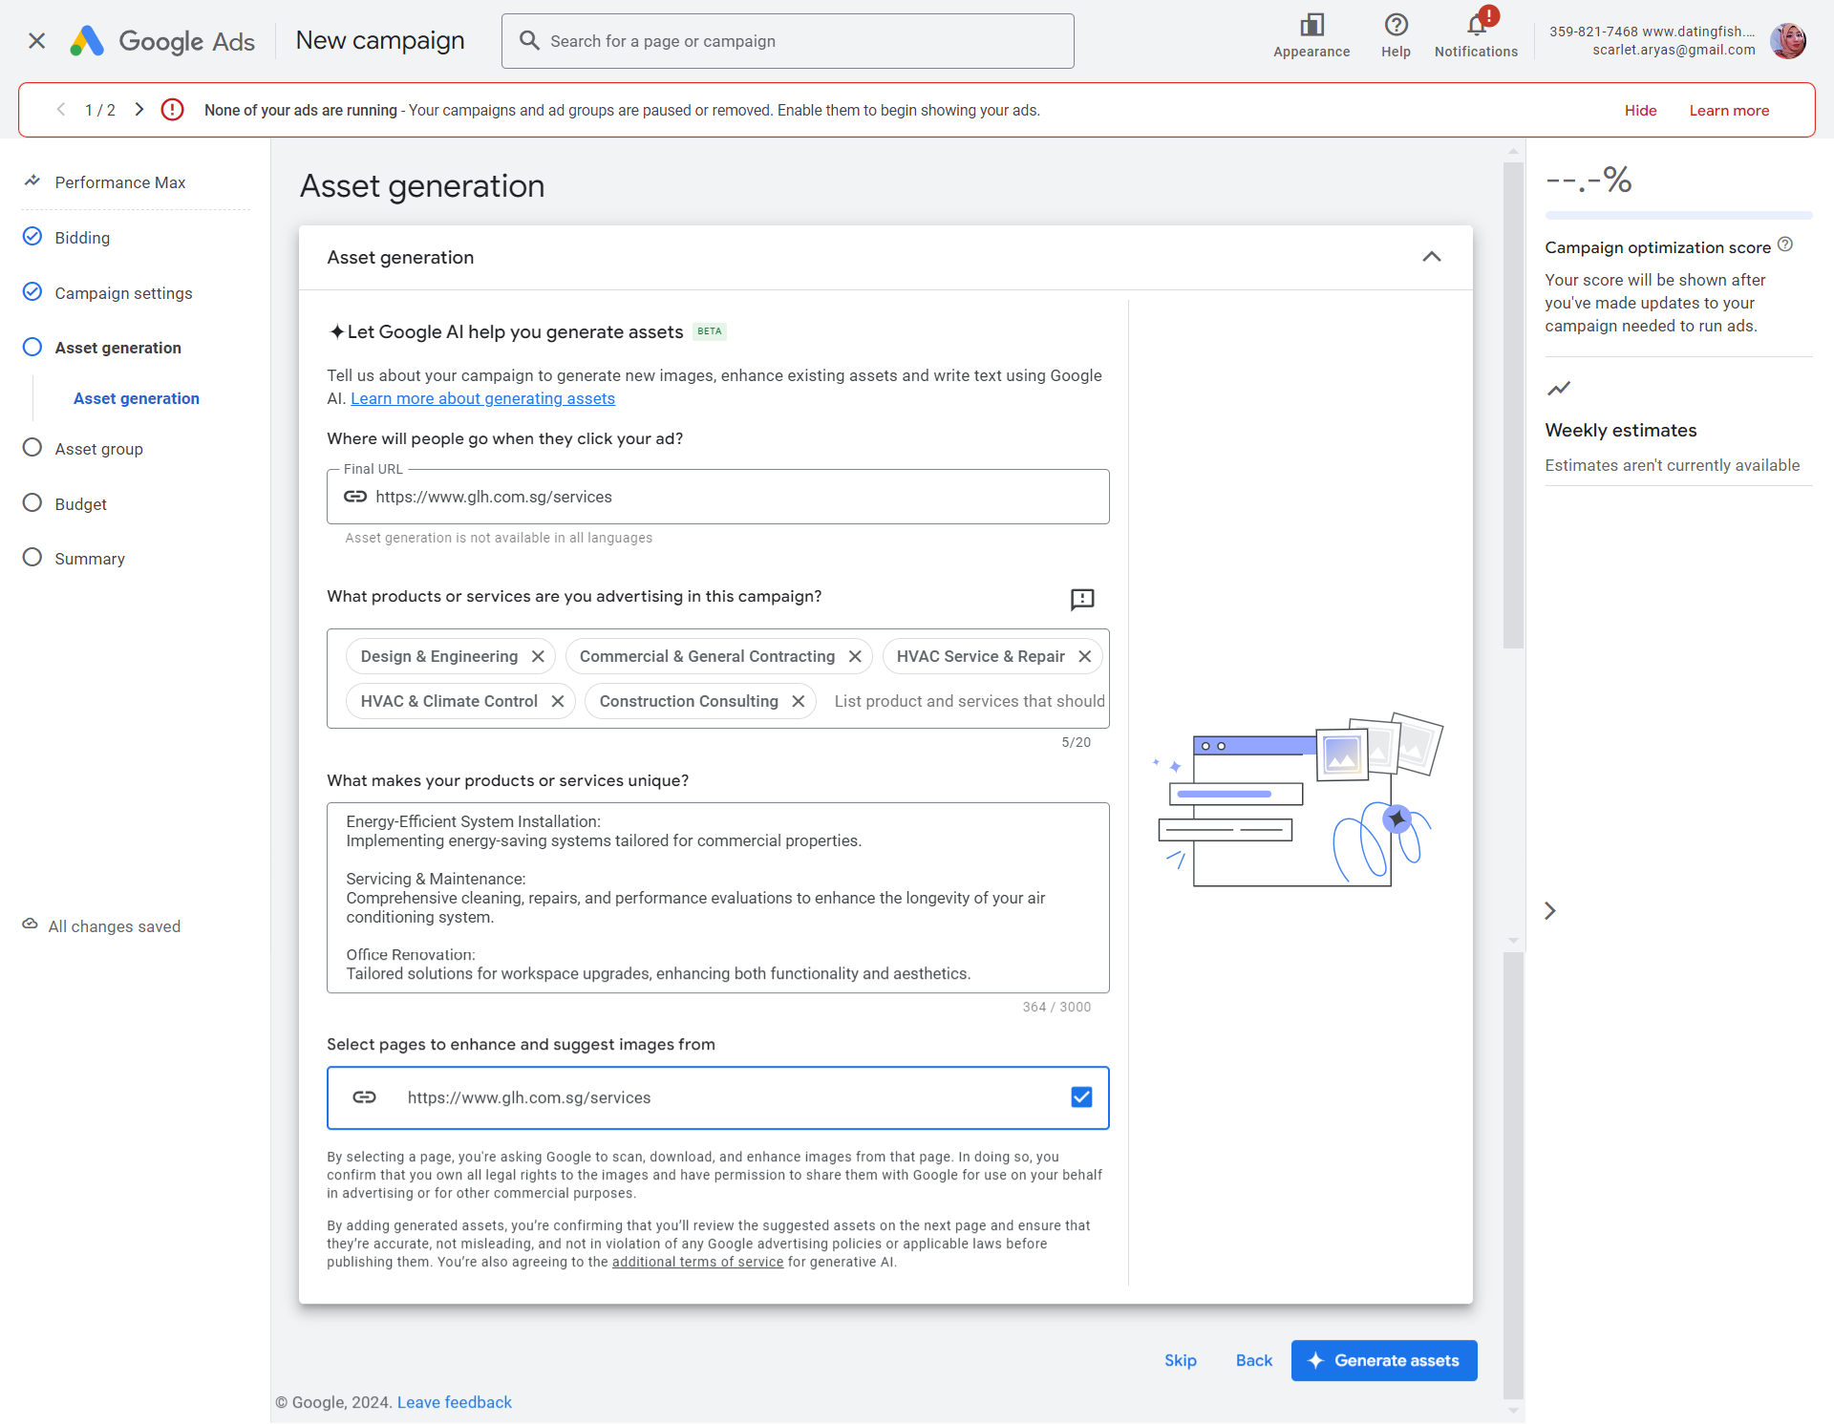
SEM – Google Search (Target Audience)

Slide 38
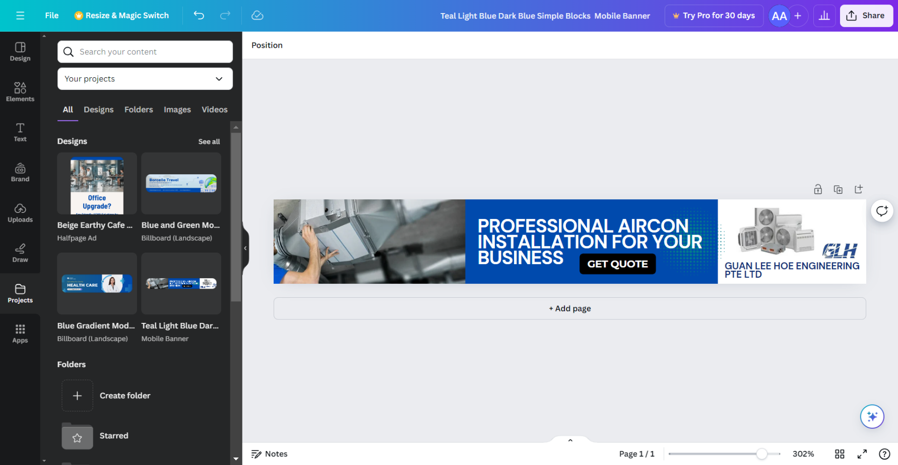
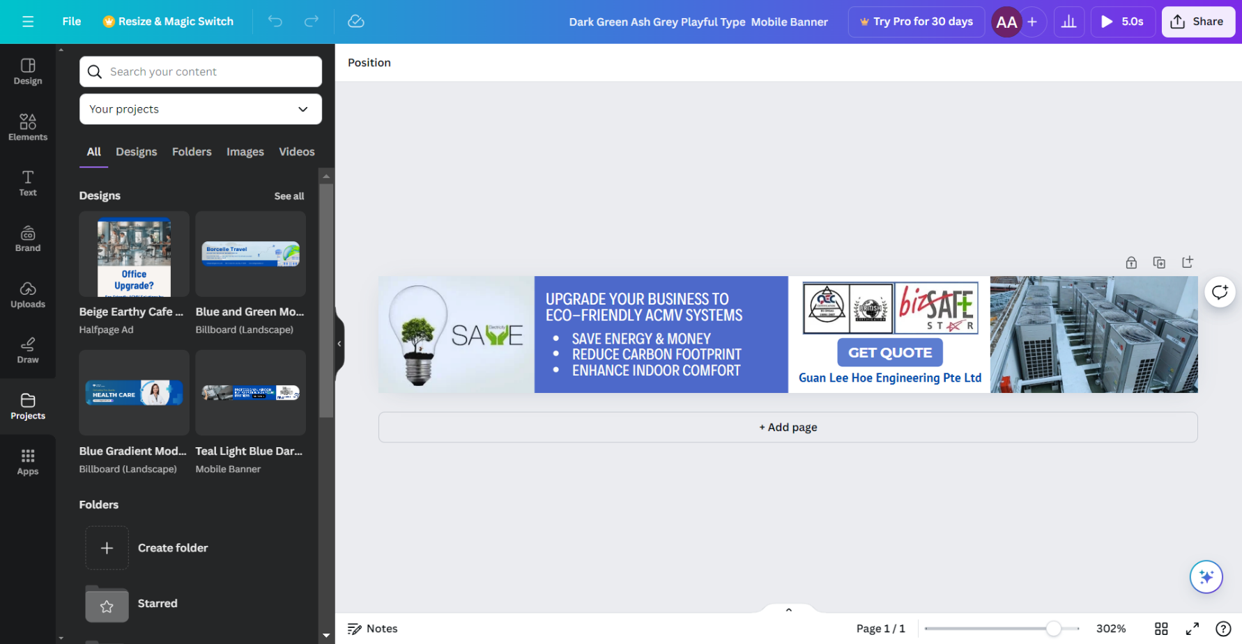
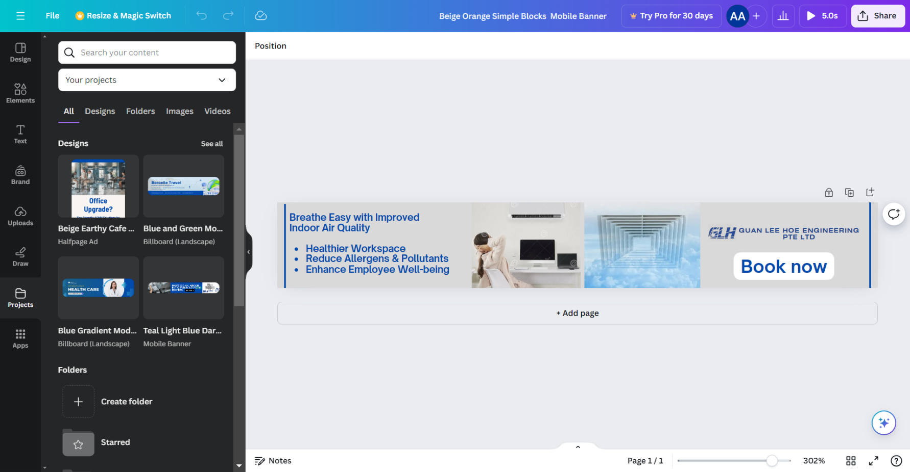
Google Display Network Ad - Mobile Banner
Mobile Banner Ad is consisting of
Headline – in summary of content message
Image / video – relevant to business brand
Product/Service – content message
Call to Action – contact or email
Branding – business logo and URL

Slide 39
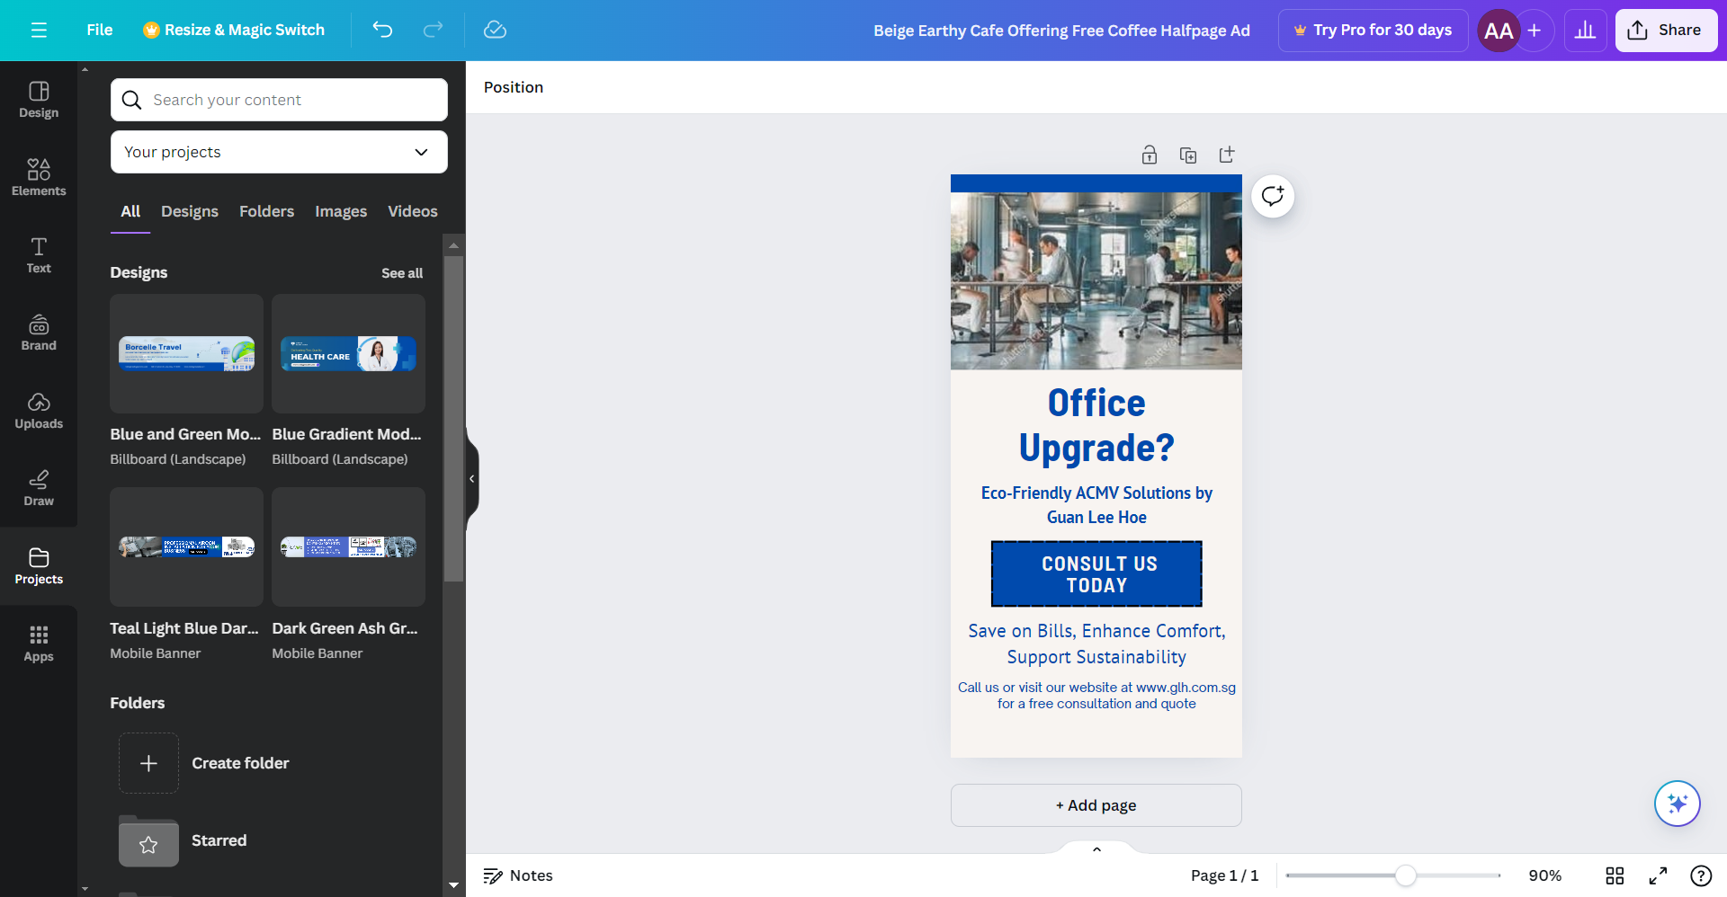
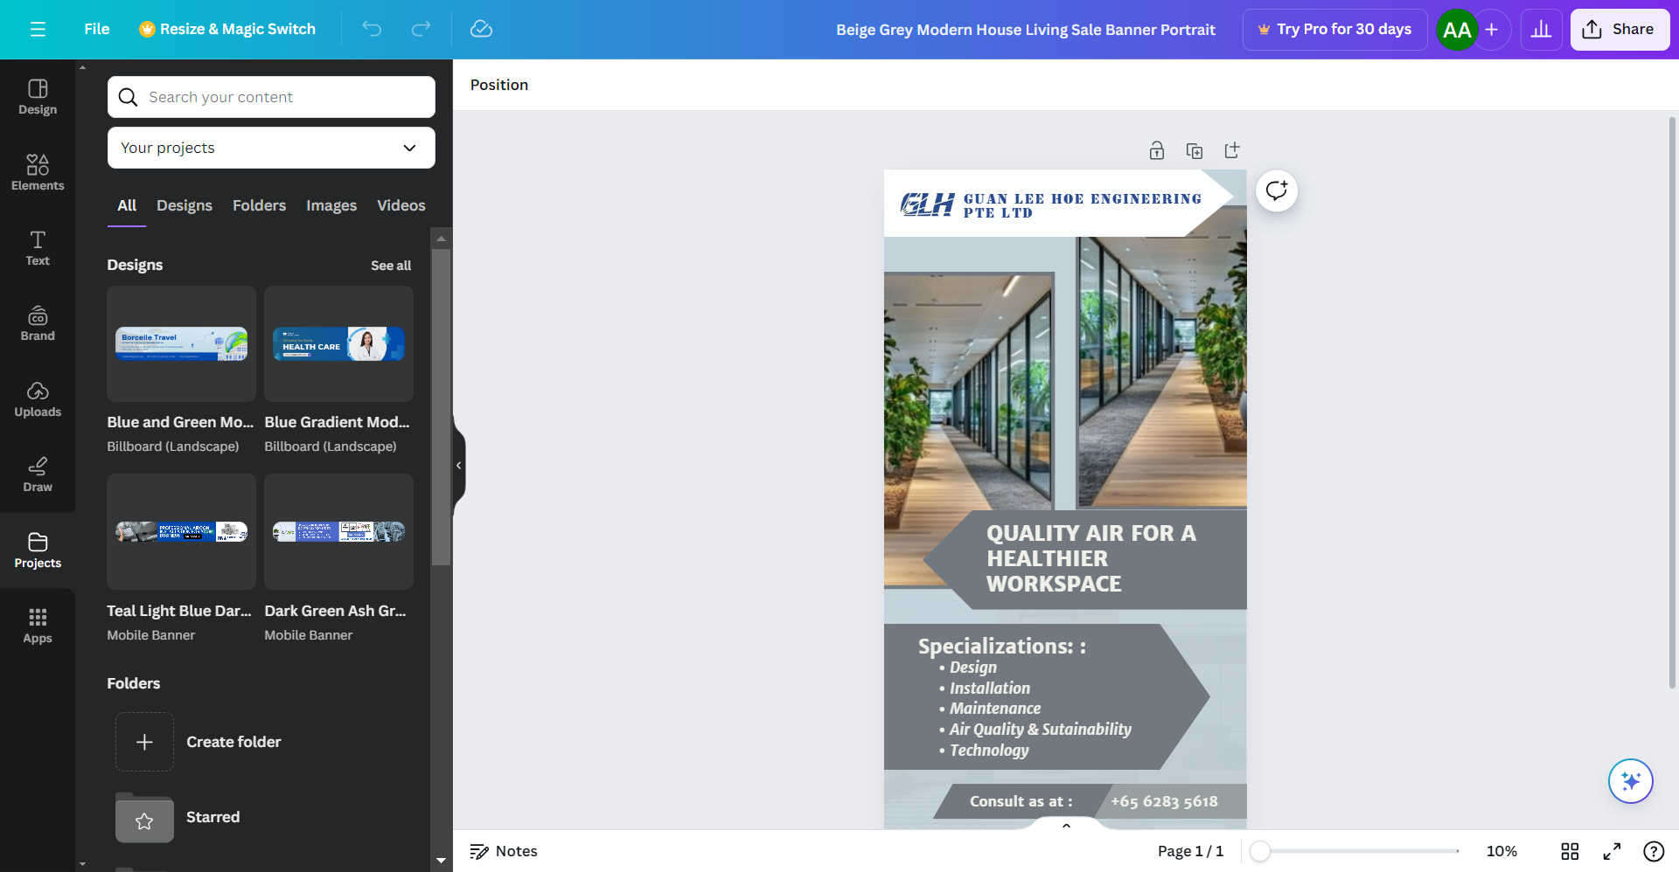
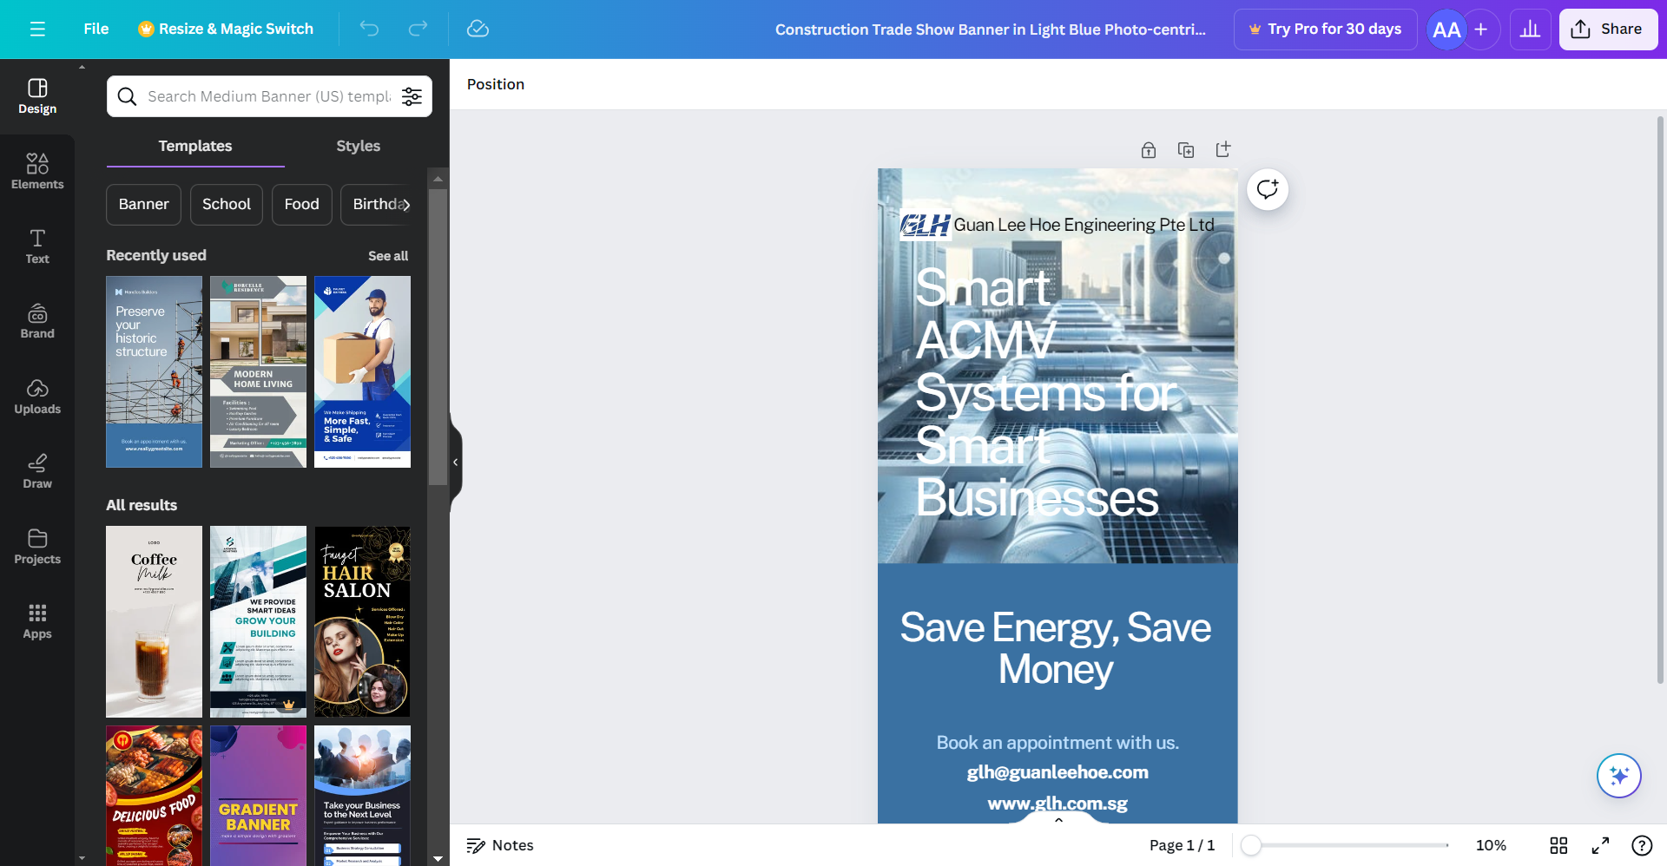
Google Display Network Ad – Half Page
Half Page Ads is consisting of
Headline – in summary of content message
Image – relevant to business
Product/Service – content message
Call to Action – contact or email
Branding – business logo and URL

Slide 40
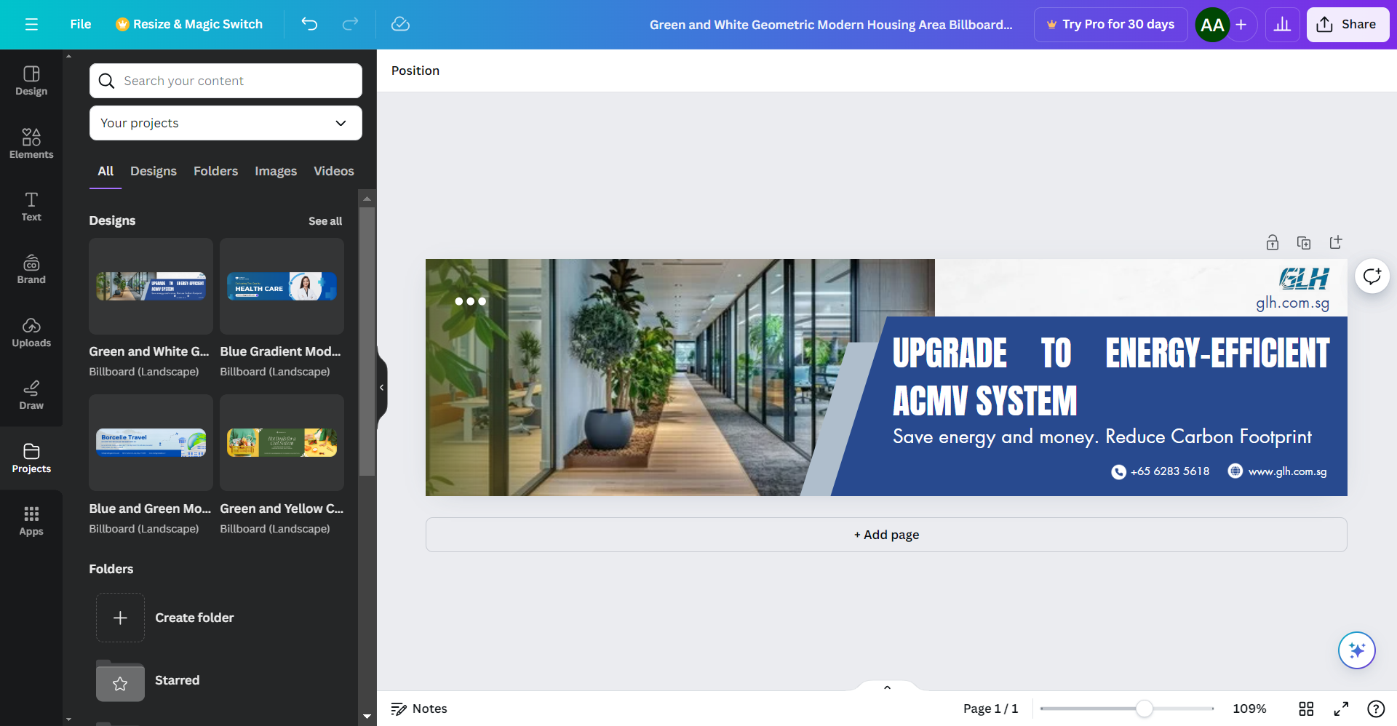
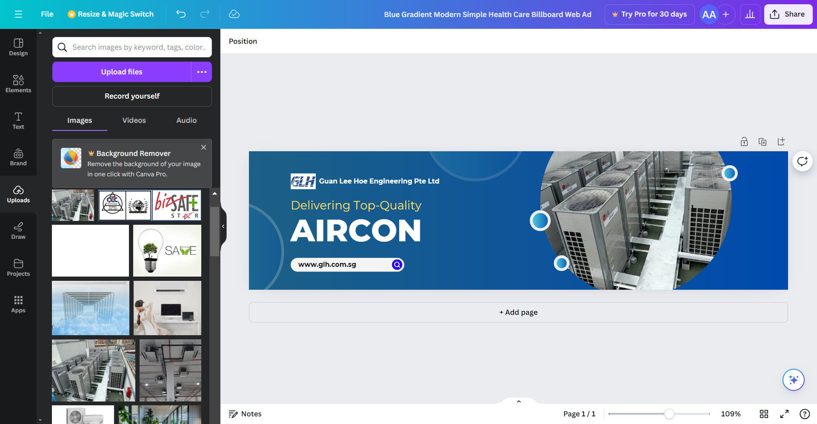
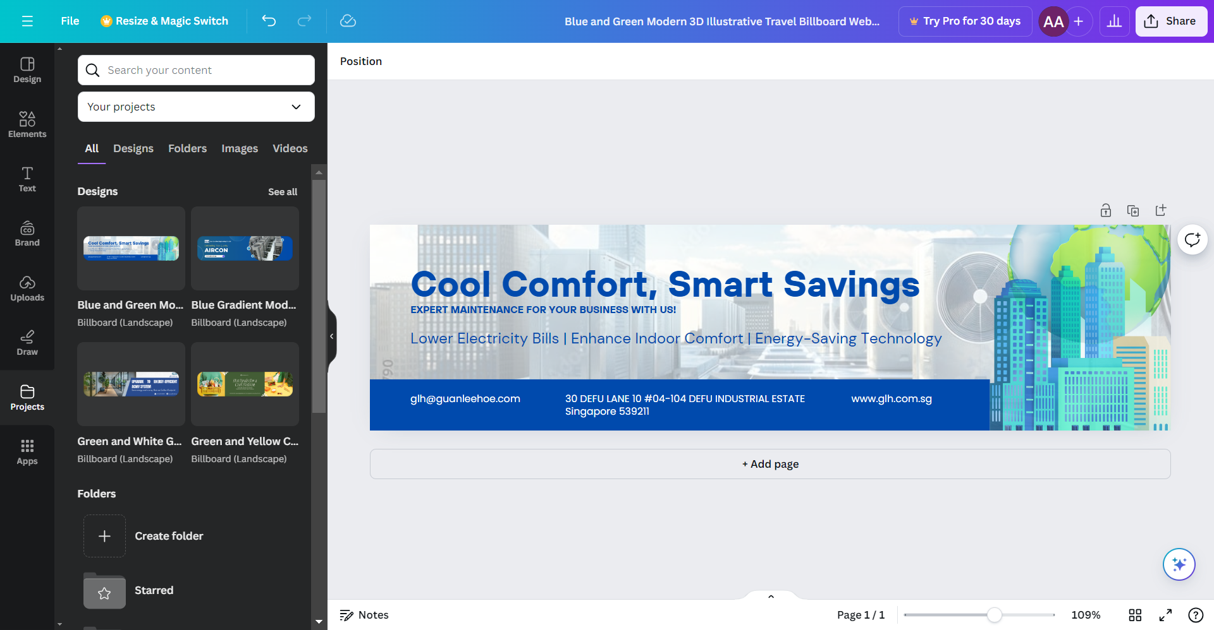
Google Display Network Ad – Billboard
Billboard Ad is consisting of
Headline – in summary of content message
Image / Graphics – relevant to showcased product/services
Body Copy – Additional short content related to product/services
Call to Action – website, contact e.g call or email
Branding – business logo

Slide 41
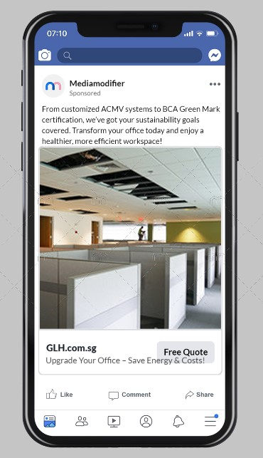
Facebook Ad (mockup)
Platform: Facebook Mobile Ad
Headline: "Upgrade Your Office – Save Energy & Costs!“
Copy: Customized ACMV systems, BCA Green Mark certification, healthier workspaces.
CTA: "Free Quote“
Visual: Modern office space
Target: Businesses seeking energy-efficient solutions

Slide 42
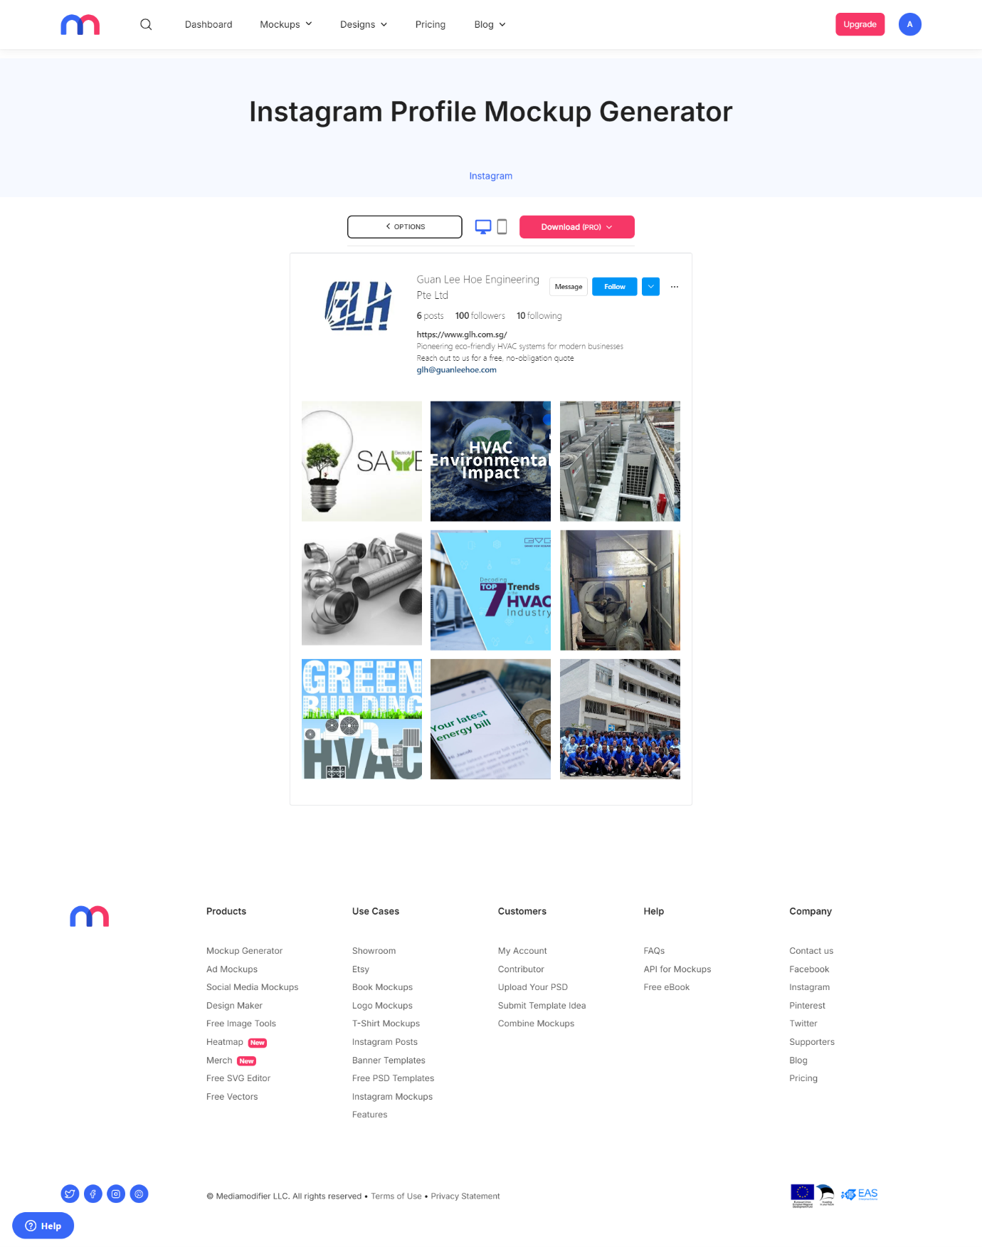
Instagram (mockup)
Profile: Guan Lee Hoe Engineering
100 followers, 6 posts.
Bio: Energy-saving HVAC systems, free quote offer.
Posts: Focus on eco-friendly solutions, industry trends, and equipment visuals.
Purpose: Promote HVAC expertise and encourage inquiries.

Slide 43
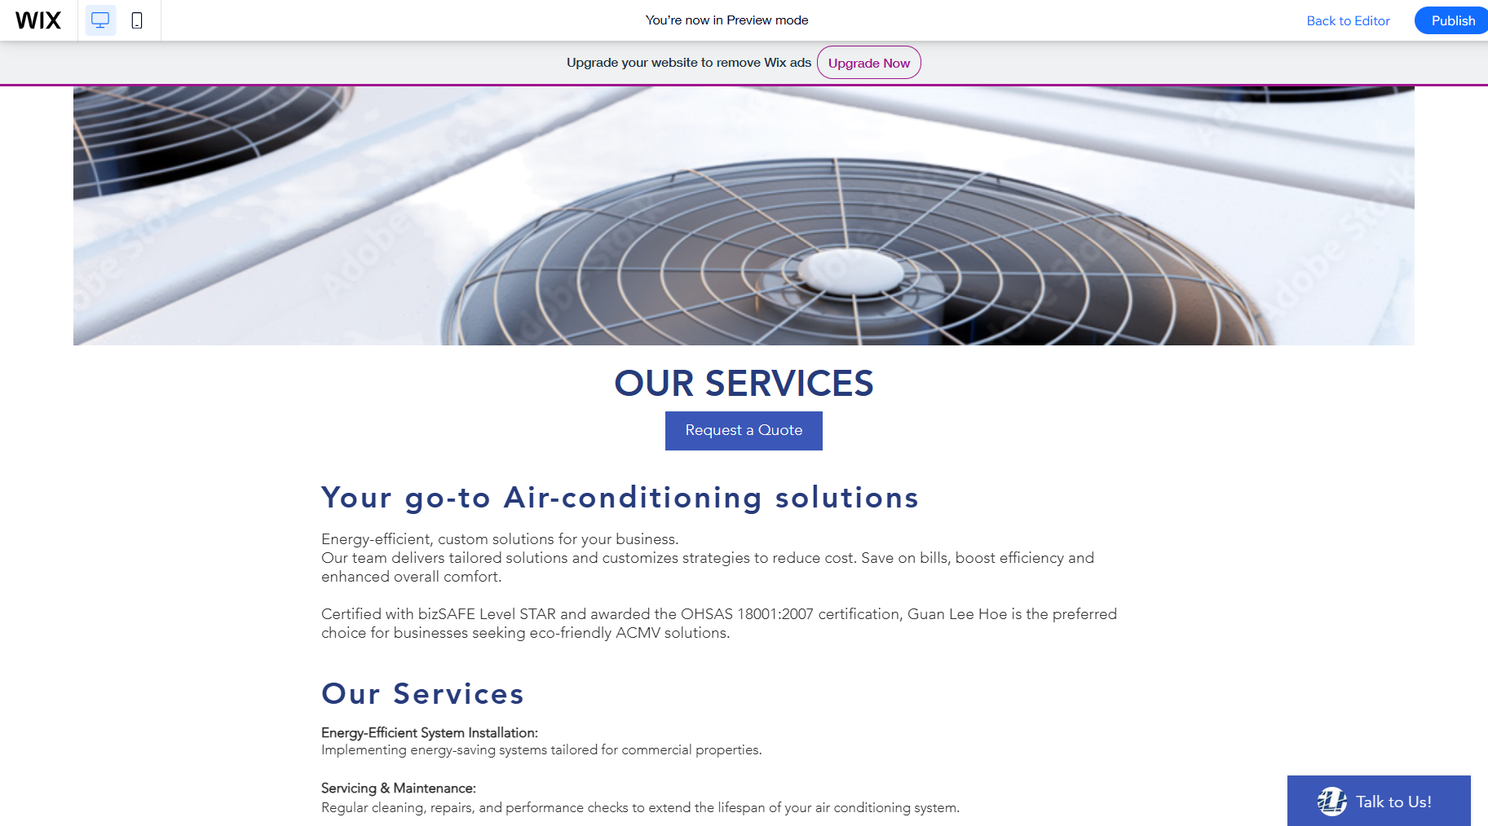
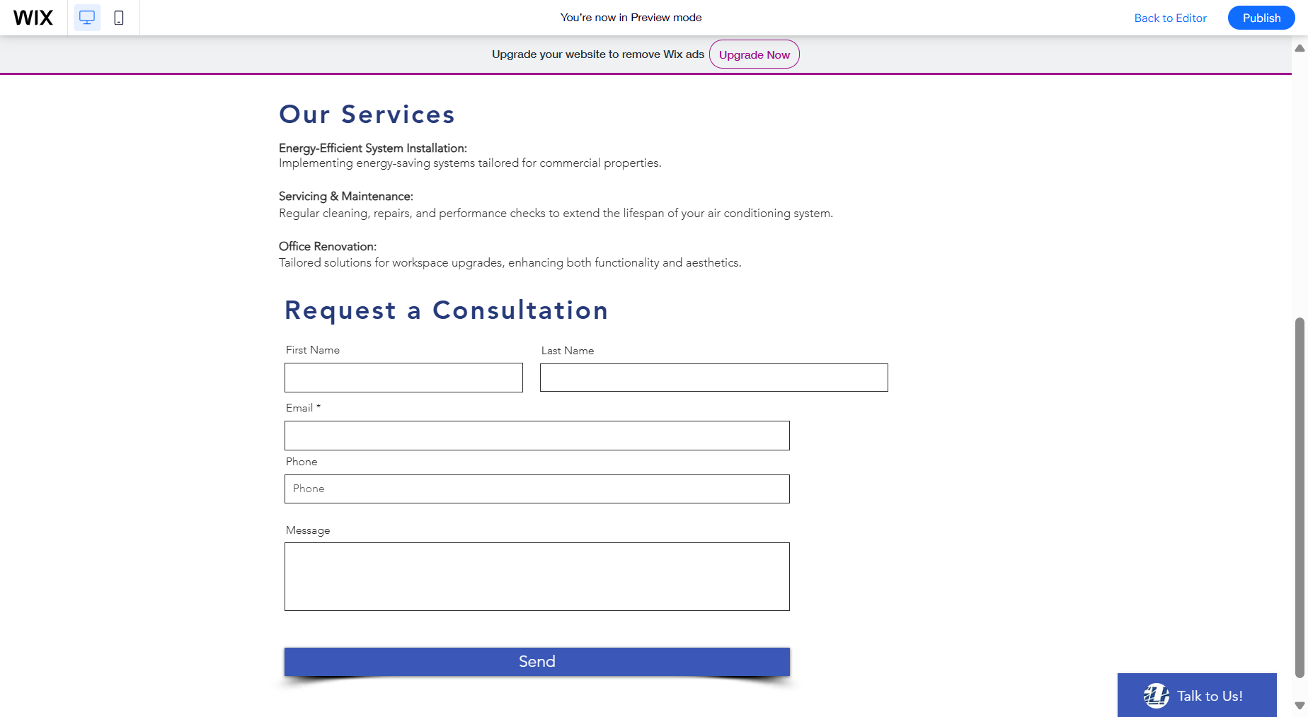
Landing Page

Slide 44
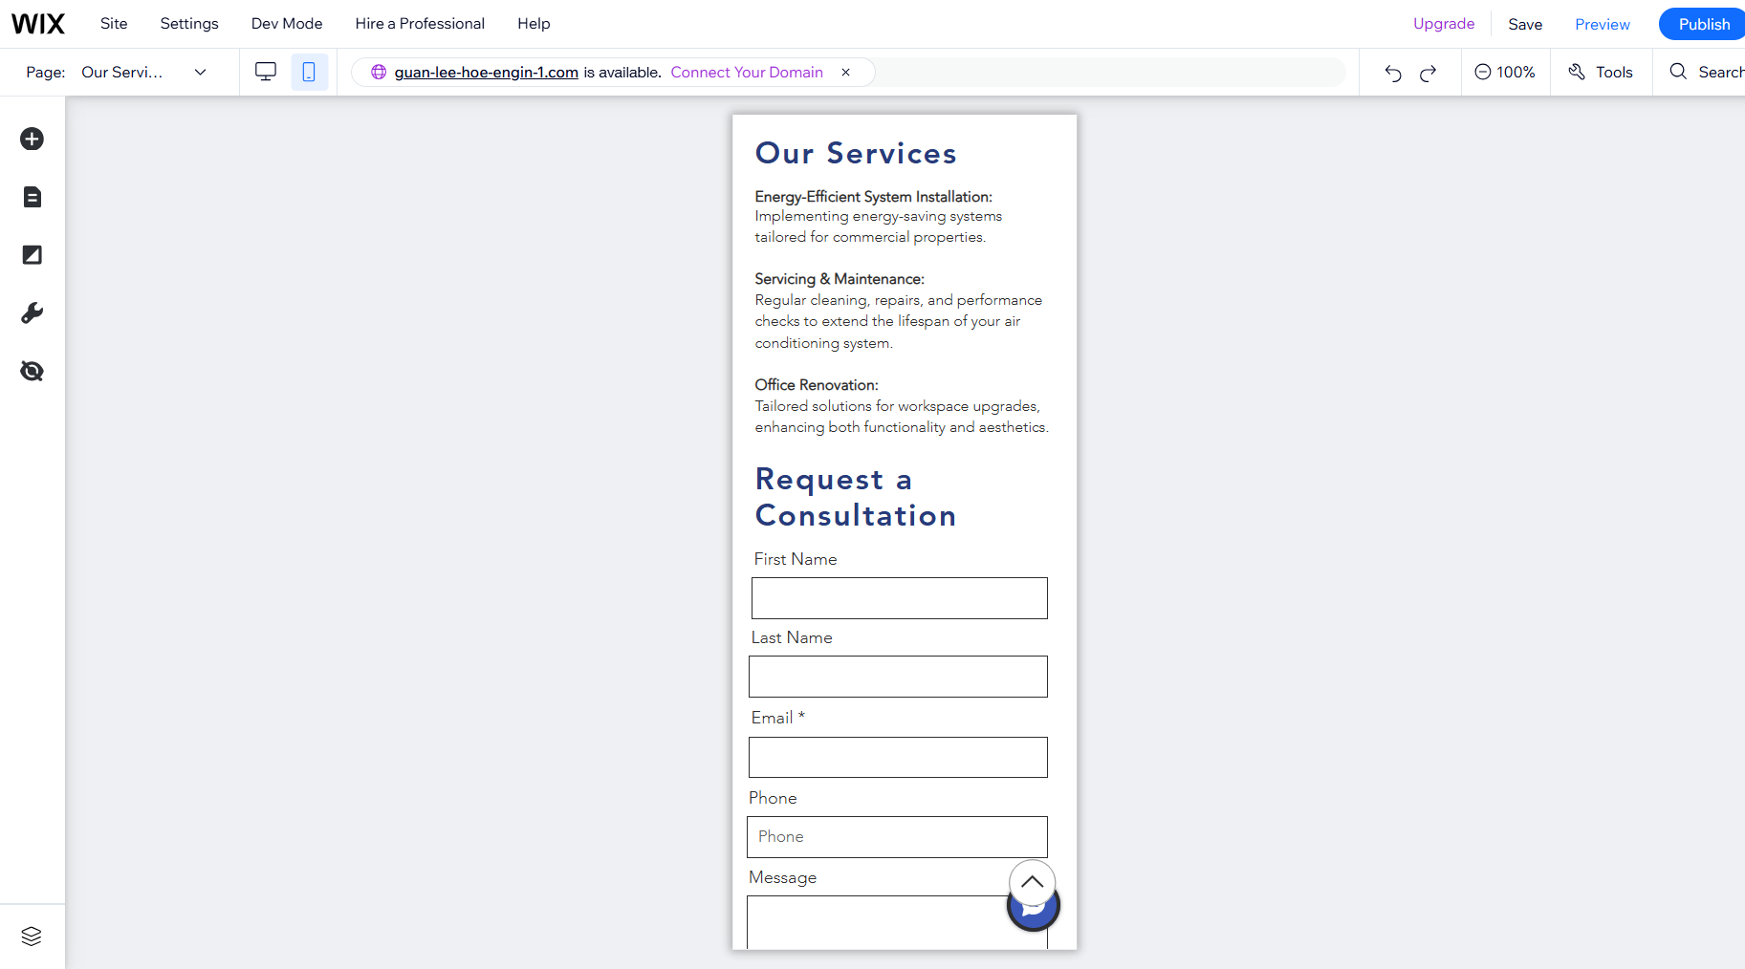


Landing Page – Mobile View

Slide 45



THANK YOU
+65 9227 1407
aida.abdrahmanr@gmail.com

